Slide 1

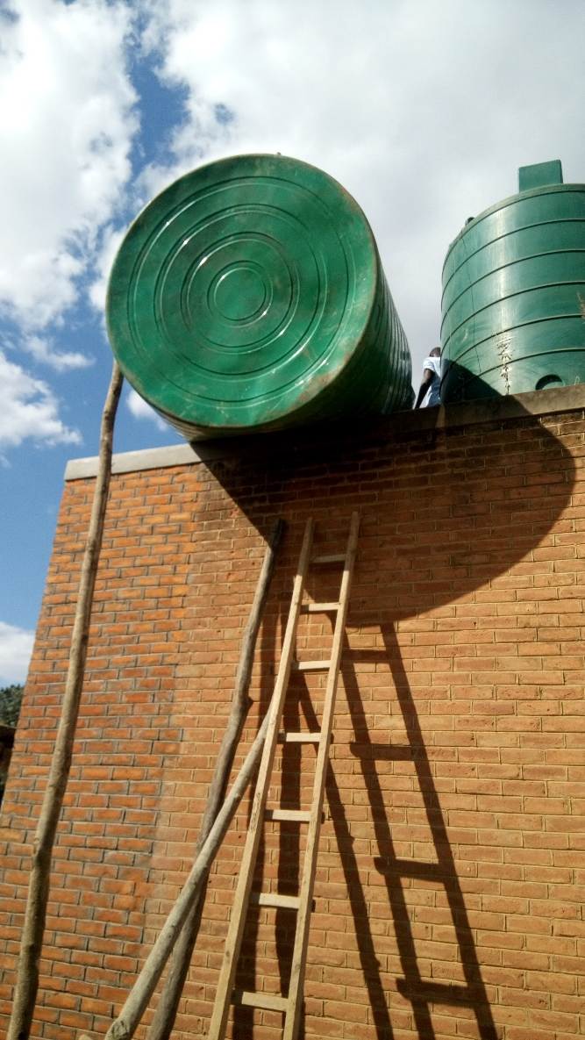
Hardware Sustainability
Buy Local – Build Local
  Look for commonly used materials – easily sourced for repairs
  Look for commonly used construction techniques (Concrete block vs cast-in-place concrete, steel vs concrete vs plastic tanks) – repair expertise will be available
  The capital dollars go into the local economy
Commonly Used Technology
  Spare parts
  Logistics of delivery
  Availability of skilled labor in the community or the area
Ease of O & M
  What can they maintain? (expertise)
  Easier lasts longer
Notes:
Introductions:
Developed By:
Dave Sacco – Northeast Region TAC Chair, Mentor for Yale University – Cameroon
Melissa Montgomery – Project Engineer at EWB-USA HQ
Kelly Latham formerly EWB-USA
Handout

Slide 2
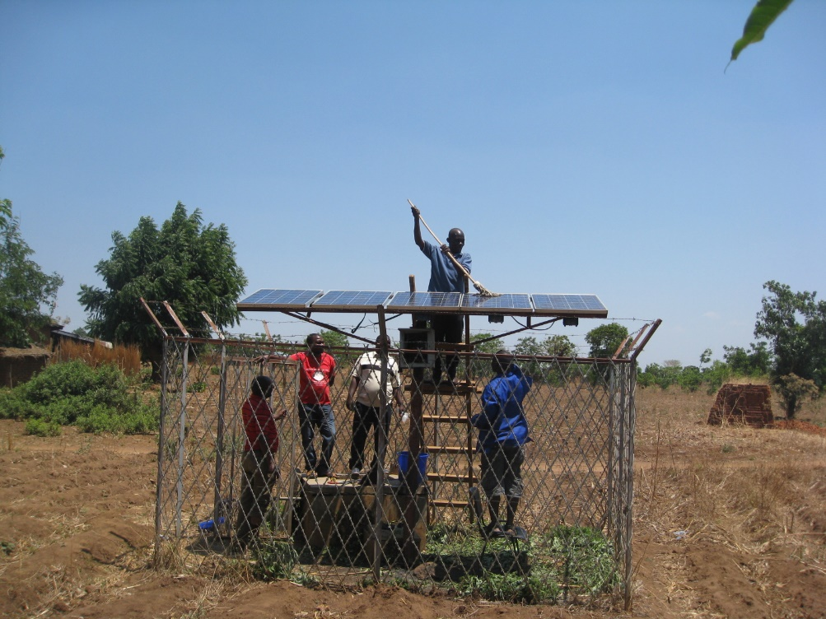
Costing
Capital Cost (Donor Dollars)
O & M & Replacement Cost (Community Dollars)
Quality
  Price vs life span
  Affects the balance of capital cost vs maintenance cost.
  What can the donor afford vs what the community can afford.
Cascade Effect
Example
Notes:
Introductions:
Developed By:
Dave Sacco – Northeast Region TAC Chair, Mentor for Yale University – Cameroon
Melissa Montgomery – Project Engineer at EWB-USA HQ
Kelly Latham formerly EWB-USA
Handout

Slide 3
Costing
Cheap is not Necessarily Cheaper
Low Quality Build Shifts the Costs to the Community
Community Cash Flow (what can they afford??)
Limited Life Span and Economic Effect
Notes:
Introductions:
Developed By:
Dave Sacco – Northeast Region TAC Chair, Mentor for Yale University – Cameroon
Melissa Montgomery – Project Engineer at EWB-USA HQ
Kelly Latham formerly EWB-USA
Handout

