Slide 1
The Three Star Approach to WASH in Schools
Nuts and Bolts of WASH Grants – Sustainability
Nov 20 2020

Slide 2

No
Star
Notes:
The incremental approach is designed to be adapted to a local context and to leverage community buy-in and commitment from school leadership, teachers and students.
‘Keep it simple, scalable and sustainable’ is the guiding concept for interventions at all stages of the process, so it can be inexpensively expanded.

Slide 3
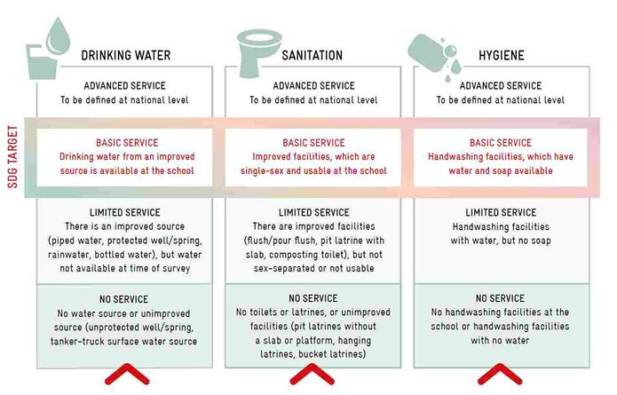
Notes:
It is no coincidence that the three star approach uses a step-by-step incremental approach to achieving improved WASH provision in schools, the approach lends itself to the Joint Monitoring Programme service ladder and is applicable to all schools in all contexts.
Regardless of where schools see themselves on the ladder, the route to basic and advanced WASH service is the same and is clearly laid out.
The approach provides a clear path for schools to move off the bottom of the ladder and fills the gap between ambitious, long-term national strategies and shorter-term WASH in Schools’ programmes, and the manual provides that starting point.

Slide 4
A two stage process
Notes:
There are two main stages to the TSA
The first and most important stage is when a school commits to the overall approach and begins to make the necessary changes to progress from being a ‘no-star school’ to a One-Star School that meets key minimum standards for a healthy, hygiene-promoting school.
The second step is for schools to then progress to two and three star status, driven by the schools themselves.
Important to point out that expensive WASH infrastructure in schools is not necessary to meet these initial health goals.
In the many schools that already have basic facilities, hardware improvements will require minimal investments and consist mainly of constructing low-cost group hand-washing stations. In some schools, additional but still modest investments will be made for construction or rehabilitation of low-cost toilets. In all cases, investments in hardware will be limited to those facilities and supplies, such as soap, that are necessary to encourage and reinforce behaviour change and achieve the minimum standards (schools that are already achieving minimum standards can aim higher).
A ‘no star school’ is a way of describing schools that have no water, sanitation and hygiene (WASH) facilities or regular hygiene programming.
Moving from the ‘no star’ level to a One Star School is designed to require minimal financial investments.
Yet, the move is a big step because it involves changing the way WASH in Schools programming is perceived by schools, communities, and decision makers in government and support agencies.

Slide 5



1-star school - Daily routine to promote healthy habits
Handwashing
Toilet
Maintenance
Drinking
Water
Notes:
Achieving one-star status requires that schools meet the following three criteria for hygiene, sanitation and drinking water, which are that:
All children participate in daily supervised group hand washing with soap, normally before the school meal
The school has basic gender-segregated toilets and has daily supervised cleaning of toilets, and provision of soap and water (at least one functional toilet for girls and one for boys); no open defecation
Daily supervised use of drinking-water bottles by all children

Slide 6
Active
School
Staff and leadership commitment
Support for teachers and staff
Curriculum
WASH clubs
Notes:
The entire school community takes the lead for meeting the One Star requirements, both community support and support from the national education system and other government bodies are important, but schools themselves are the driving force and must be actively engaged.
Teachers and headmasters’ must be willing and able to take on the extra-curricular responsibilities necessary for reaching and maintaining One Star status.
This will require preliminary engagement and regular follow up with schools through the education system and other government institutions .
Additional support for teachers and headmasters may also be needed, such as manuals or templates, and training (and which is where I see NGOs’ support being most needed).
Longer term, integration of TSA into the curriculum is important and could include making monitoring part of school inspectors’ official duties and including it in training programmes for teachers.

Slide 7
Community Support
Staff and leadership commitment
Support for teachers and staff
Curriculum
WASH clubs
Notes:
Schools must have strong support from their communities in order to reach and maintain One Star status and its a precondition for becoming a One Star School that community members, teachers, headmasters and local government officials work together.
Many schools will already have associations that can fulfil this role.
support for teachers in their daily activities and
serve as liaisons between schools and parents, who are often the strongest stakeholders in advocating for school improvements.
they can raise funds and other resources to achieve goals,
such as funds for soap or soap making, and
labour and
materials for repairing or building toilets and hand-washing stations.
Active committees can source resources locally, act as advocates to request support through the education or local government systems as needed.
Some external support from the education system and partner agencies or non-governmental organizations may also be necessary, especially in the initial stages of the programme. This support, however, should generally not include funding for hardware or supplies.

Slide 8
Simple
Scalable
Sustainable
Needs assessment
Inexpensive steps
Local knowledge, resources and technology
Step-by-step
Local to national
Minimal investment to start
Incremental
Stakeholder involvement
Demand driven
National alignment
Notes:
The Three Star Approach draws on the capacities and local resources of schools and communities while tapping into the enthusiasm and energy of children through group activities for hygiene, sanitation and water.
These daily group activities help children build good hygiene habits that will last a lifetime.
By prioritizing the most essential actions for achieving goals, the Three Star Approach helps schools focus on meeting children’s needs through key interventions. At the same time, it provides a clear pathway for all schools throughout a country to meet national standards, and for all children to have hygiene-promoting and healthy schools.

