Slide 1
WaSH In Schools: the classroom component
Carolyn Johnson
Yarmouth Rotary, Maine, USA
Chair, BELRAG (Basic Education & Literacy Rotary Action Group)
WinS Target Challenge Advisory Committee
cfj2@icloud.com

Slide 2
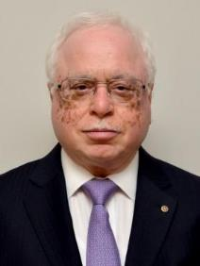


“Bring the toilets into the classrooms, then into the homes”
Trustee Sushil Gupta
Chair of the WASH in Schools Committee
Rotary Foundation Trustee 2014-18
Trustee Sushil led the effort to create the Target Challenge strategy by working with fellow Rotarians, Rotary Staff and colleagues at UNICEF. He chaired the WASH in Schools Target Challenge Committee, which guides and directs the pilot program.
WinS was conceived in 2013, to bring two Areas of Focus together to work collaboratively and to enhance the work of each. In 2014, a working group was developed to create a framework. The WinS Target Challenge Pilot was adopted by the Trustees.
Notes:
Rotary aims to improve the quality and sustainability of its WASH in Schools projects. The WASH in Schools (WinS) Target Challenge pilot program launched in January 2016 and is running until June 2020. The program was created to motivate Rotary clubs to develop sustainable water, sanitation, and hygiene, and educate projects using the expertise and resources available through two of Rotary’s causes: basic education and literacy and water, sanitization and hygiene.
WASH in Schools enhances education experiences for all students, providing a healthier, safer environment where they can develop, thrive and become strong advocates for their communities

Slide 3
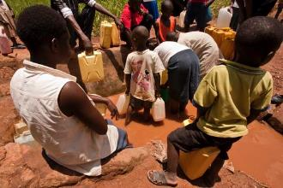
Hygiene Education
vs Hygiene Promotion
A child or group of children | spread knowledge teach skills demonstrate by example | work together younger children peers family community
Notes:
Education denotes child (student) receiving knowledge from teacher (filling an empty vessel)
Promotion of a topic or concept implies comprehension & internalization - so it is spread beyond the four walls of the classroom or school (creating capacity)
Child to child & child to community hygiene promotion approaches recognize the responsibilities children often have in developing countries (looking after younger siblings, etc) and therefore the role they can play to influence their siblings and other family members to adopt safer hygiene practices.

Slide 4


WASH in Schools
Three main principles:
Visible: throughout the school & the school day. Impact on school culture.
Inclusive: reach every child at an appropriate level. Involve, families, teachers, wider community
Sustainable: improve instruction by incorporating WASH principles into the curriculum and learning

Slide 5
Using Curriculum Standards to promote hygiene habits
WASH Activities
Hand Washing
Use the toilet, latrine
Drink safe water
Personal Hygiene
Grade 2 Curriculum Standards
Ministry of Education, Guatemala
(Sciences, Communication & Language)
  Practice hygiene habits to keep you and your community healthy
  Bath daily, wash hands, keep clean
    Identify cause & effect of common illnesses in your community
    Use preventative basics to prevent gastrointestinal illnesses
    identify forms of water contamination
    Use natural resources carefully, understand the importance of the water cycle
Demonstrate listening comprehension skills in various contexts
Interview others to learn information
Use oral & written language to express opinions
Use informative or creative writing to share and explain information
Present information indifferent ways
Notes:
Bringing hygiene promotion into the classroom -
connect to existing curriculum
make it meaningful
use as a tool for other expectations
maximize time, resources
teach in context (stronger learning model - for both hygiene and literacy)

Slide 6
WaSH connections & Enhancements to the curriculum
Science
  germs - where do they live?
  transmitting diseases
  water cycle / water properties
  how water gets contaminated
  food contamination
  Organic vs chemical fertilizers
Technology
Math
  How much water do you need (daily, weekly, monthly)
    drinking
    bathing
    cleaning
    crops
    volume (fecal matter management, storage)
    size, capacity, and production per capita of community water system
    Statistics, charts, graphs
Geography
  water sources
  maps of water tables, waterways
  Teachers Guide to Integrating WASH in Schools
  (USAID, SPLASH, Zambia Ministry of Education)

Slide 7
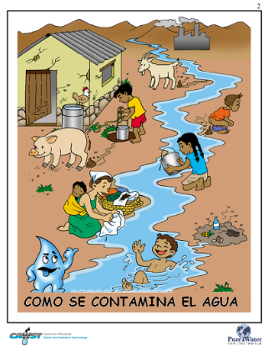
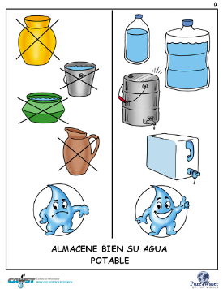
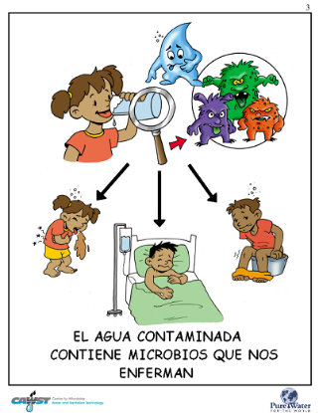
Classroom resources
Notes:
Pure water for the world
(visible reminders)

Slide 8
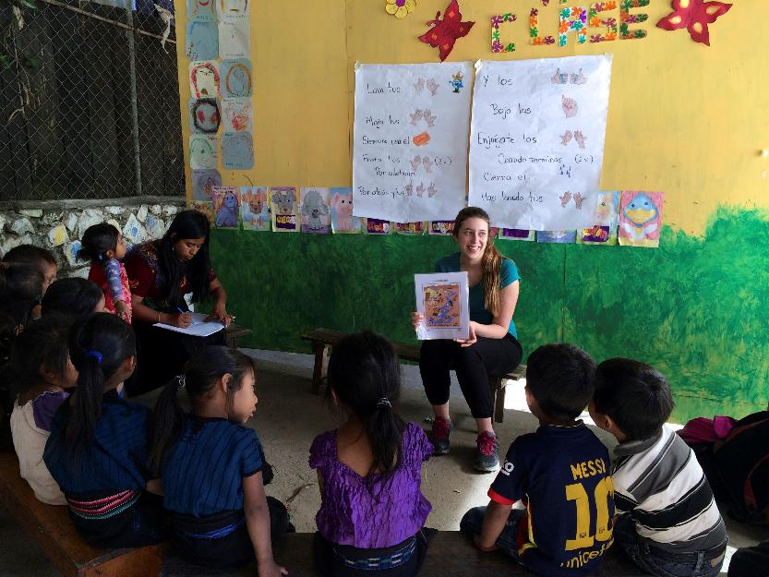
Modeling strategies for teachers
Notes:
Working with teachers to model effective classroom strategies (engaging, collaborative, connected with curriculum)

Slide 9
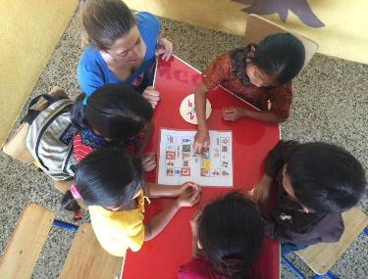
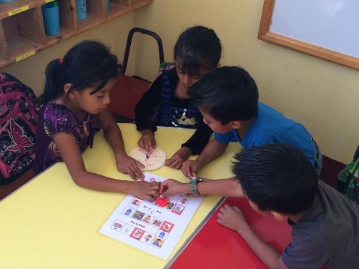
Apply information: practice using simple games
Notes:
Games to reinforce concepts - teaching vocabulary, concepts,

Slide 10
Integrate into the curriculum
Language Arts (reading, writing, listening, speaking)
  write stories (big books, little books) to share information (what was taught - a good way to check for for understanding)
  read books about the topics
  dramatize what you’ve learned (share with younger students or the community)
Civics, history, social sciences
  national sanitation policies
  water influence on community growth or policies
  traditional practices about water, hygiene

Slide 11
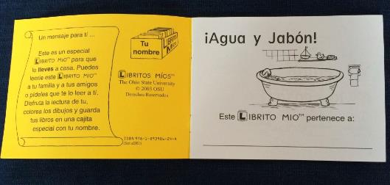
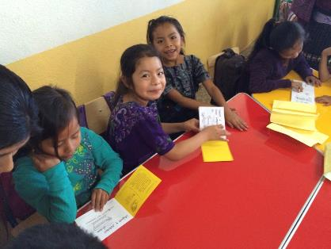
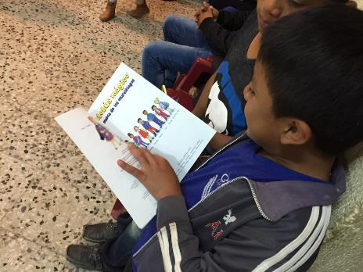
Literacy materials to support content, concepts
Notes:
Use children’s literature to share WASH key concepts - reading in context, reading for meaning

Slide 12


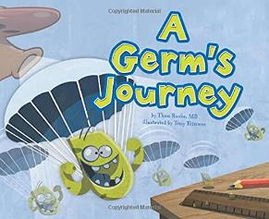



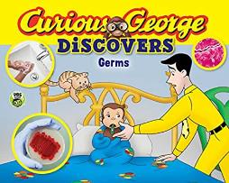
Notes:
Examples of primary school titles to include in classroom or school libraries

Slide 13
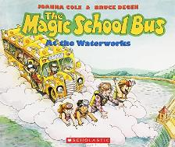

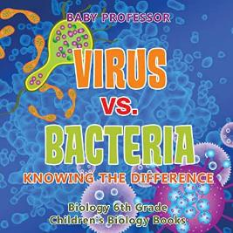
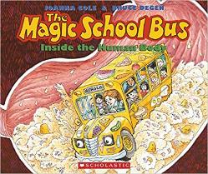



Notes:
Upper elementary, middle school literature for classroom or school libraries

Slide 14
Sustainability: Improve the quality of instruction by supporting teachers
Make it easy for teachers to use
  Identify a few lessons to incorporate WASH (age/grade appropriate)
  interactive planning sessions
  classroom resources
  offer support
  find out if it works, problem solve, adjust
Community Assessment: find out what teachers know, how they teach, professional development
Introduce effective teaching strategies
Water. Sanitation. Hygiene. Education. literacy. A guide to WASH in Schools
Rotary International, 2017

Slide 15
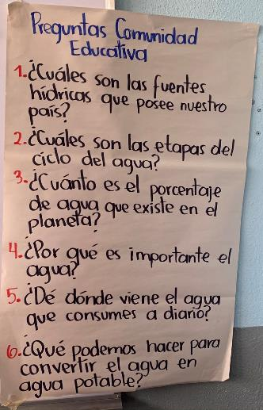
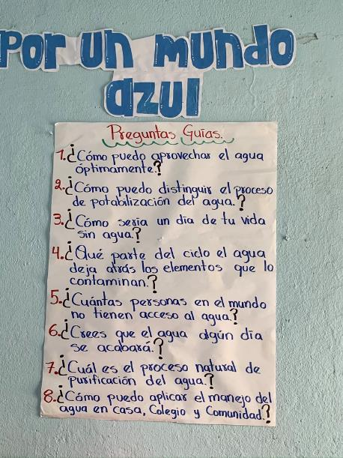
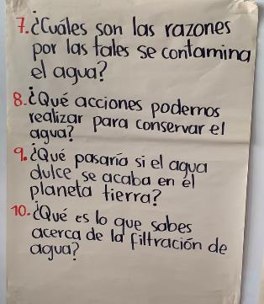
Inquiry based lessons
Notes:
Students use WASH concepts for further learning - developing their own questions (scientific process, inquiry based learning)
Guiding questions
how can we provide water
how can you tell if water is drinkable
what would a day without water be like
Where in the water cycle can water become contaminated
What is a natural process to purify water
Community education questions
What are water sources in our country
What are the stages of the water cycle
What percentage of water covers the planet
Why is water important
Where do we get our daily water
What can we do to make water drinkable
What are some reasons water gets contaminated
What actions can we take to conserve water
What can we learn about water filtration

Slide 16
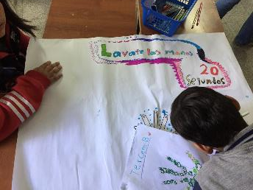
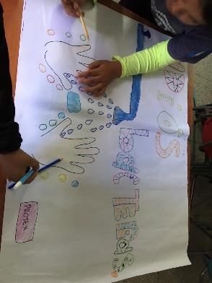
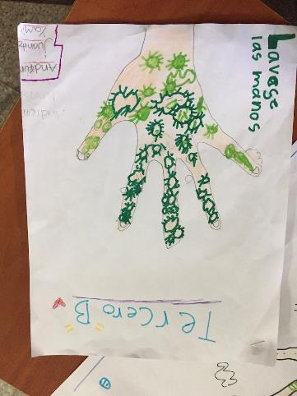
Using skills to apply knowledge
Notes:
Demonstrations of learning - show what you’ve learned. School posters

Slide 17
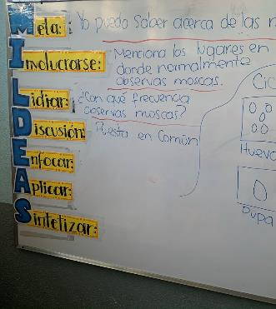
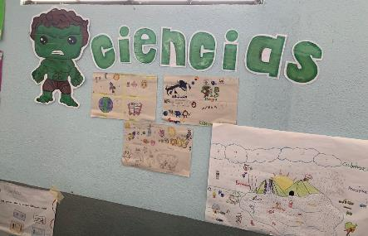
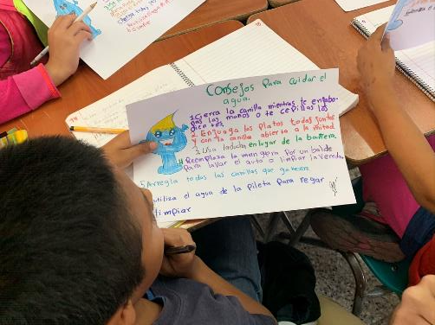
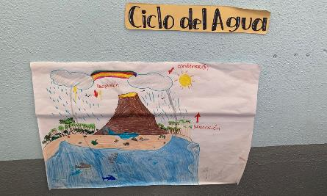
Notes:
WASH concepts imbedded in science curriculum and instruction

Slide 18
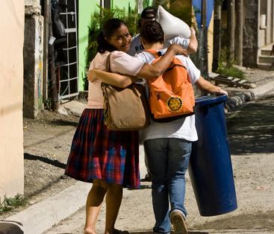
Schools Play an Important Role in Hygiene Practices
Hygiene messages in school curricula, community outreach activities and school health clubs can play a pivotal role in promoting good hygiene practices, together with the provision of safe sanitation and drinking-water. When children are included in programs as active participants and active learners, they become powerful agents of change in their own households and in their communities by passing on messages about good hygiene practices. As future generations of adults, children are critical to ensuring the sustainability of behavior change.

Slide 19

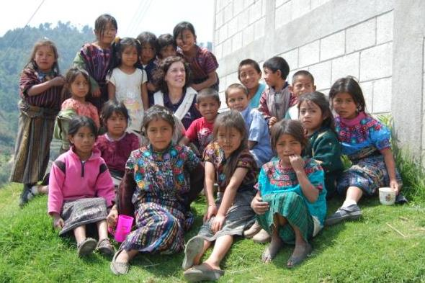
Carolyn Johnson
cfj2@icloud.com

