Slide 1

Beneficiary-Driven Approach

Slide 2

Scanning the Environment
Review
Review national, local policies & guidelines
Contact
Contact local government departments & potential collaborating partners
Identify
Identify key actors in the WASH sector

Slide 3

Benefits
Avoid
Duplication
Complement
Existing Efforts
Collaborate
within the Framework of National Policies, Acts & Guidelines
Generate
Additional External Resources (technical & financial)

Slide 4
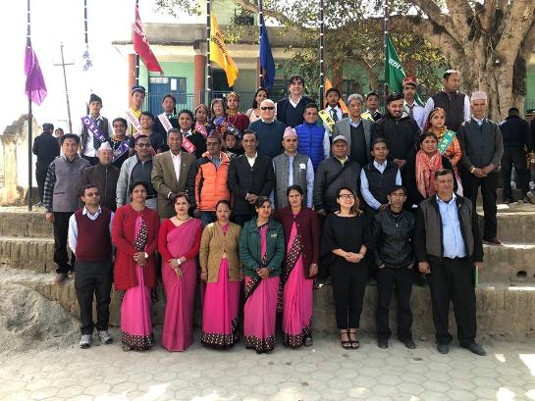
Assessment Framework
Seven Flags Approach to Total Sanitation (7FATS) in School Concept
WHO Nepal Piloted Approch based on National Policies and Guidelines

Slide 5







Assessment Framework
Use of toilet
Hand Washing & Hygiene
Equity in WASH
Menstrual Hygiene
Safe Water
Clean Environment
Safe Food

Slide 6
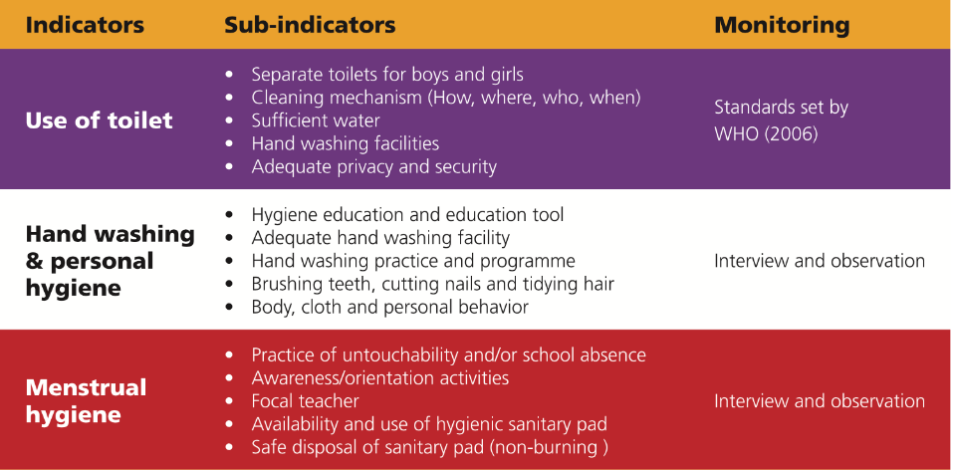
Guided Self-Assessment

Slide 7
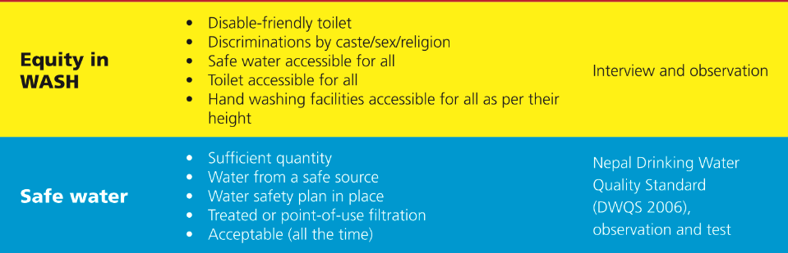
Guided Self-Assessment

Slide 8
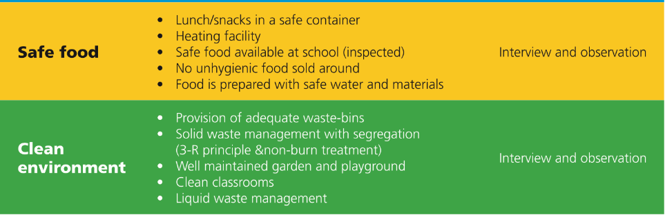
Guided Self-Assessment

Slide 9
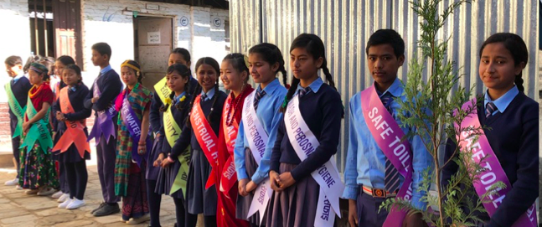
Guided Self-Assessment
Guided Self-Assessment
Needs Identification
Comprehensive Hardware upgrading
Retraining of Student Teams
Student Team Formation

Slide 10
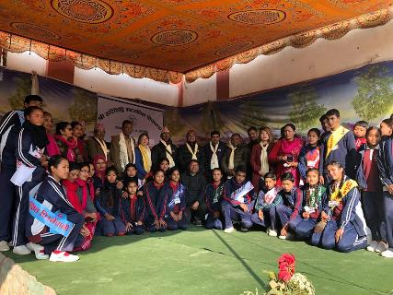
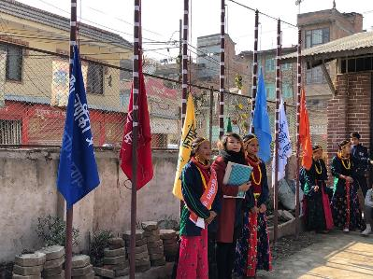
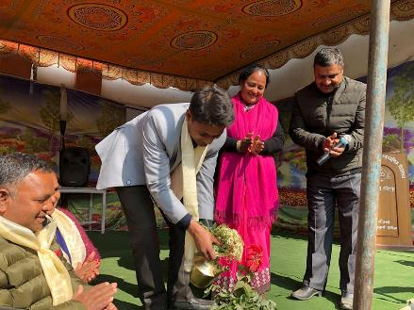
Involve all Stakeholders
Sanitation Conference – repeated annually

Slide 11

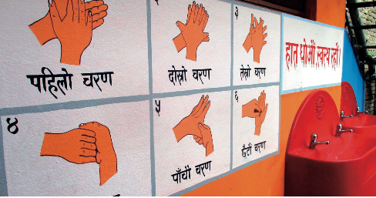
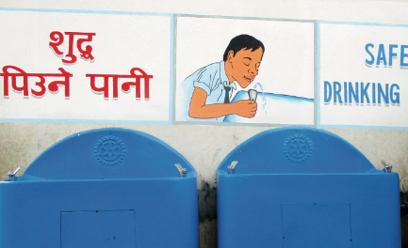
Inclusive Assessment
Commitment of school management team
Comprehensive Assessment of WASH facilities
Involving the Students in the Needs Assessment
Involving the wider community

Slide 12
Longterm Commitment
Sign a Memorandum of Understanding
Establish a WASH account in each school
Regular Monitoring visits by Rotarians
Maintenance contract with technical partner

Slide 13

Thank You!
Additional Information about the Assessment Framework
WASH HANDBOOK: Sustainable WASH in 12 Public Schools of Lalitpur District in Nepal
https://issuu.com/rotaryclubpatan/docs/rotary_gg1860104_wash_handbook_final

