Slide 1

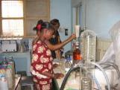
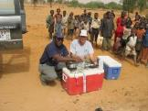

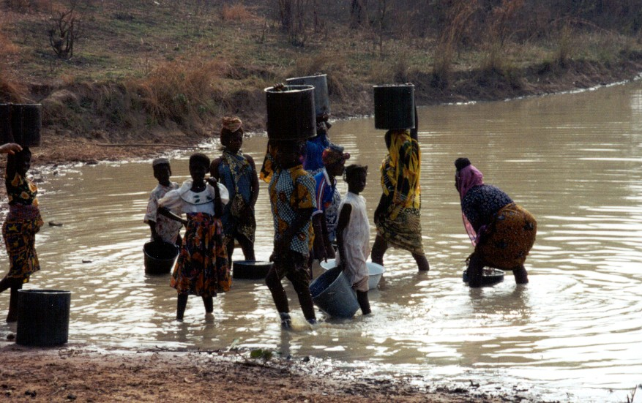
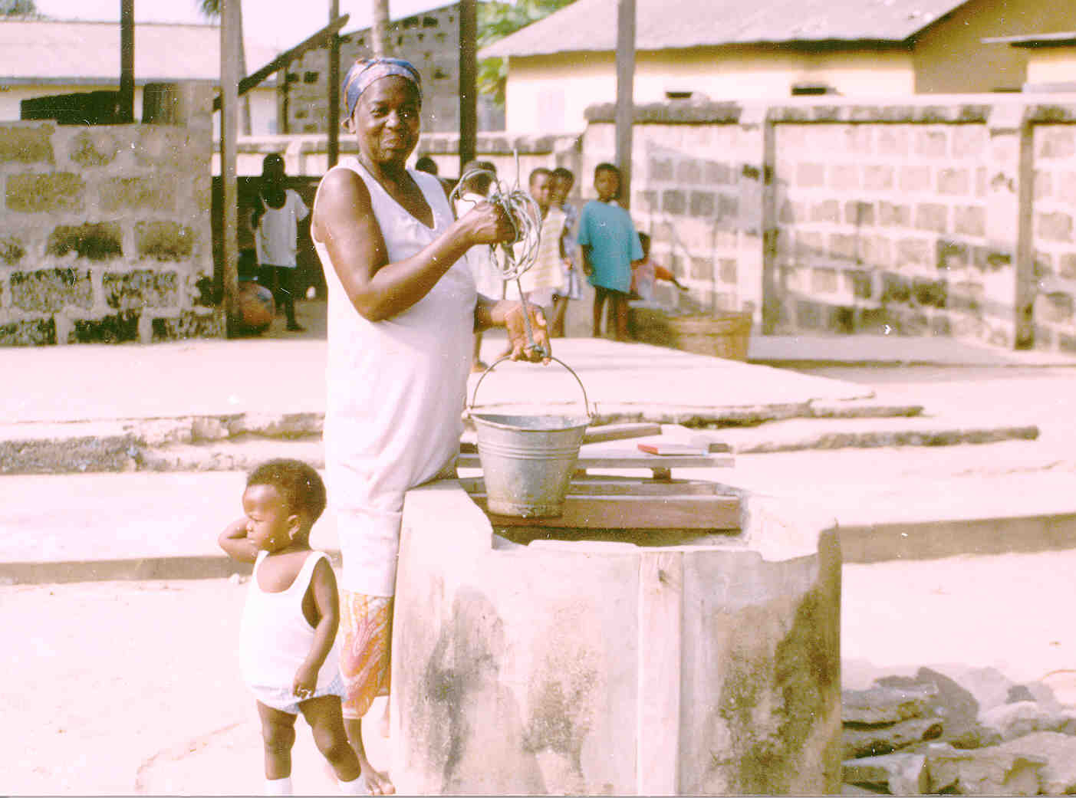
WASH Rotary Action Group Webinar
Nuts & Bolts of WASH Global Grants
Ensuring Sustainability of Hardware
Braimah Apambire, Ph.D.
Center for International Water and Sustainability
Desert Research Institute, Reno, NV
November 19 &20, 2020

Slide 2
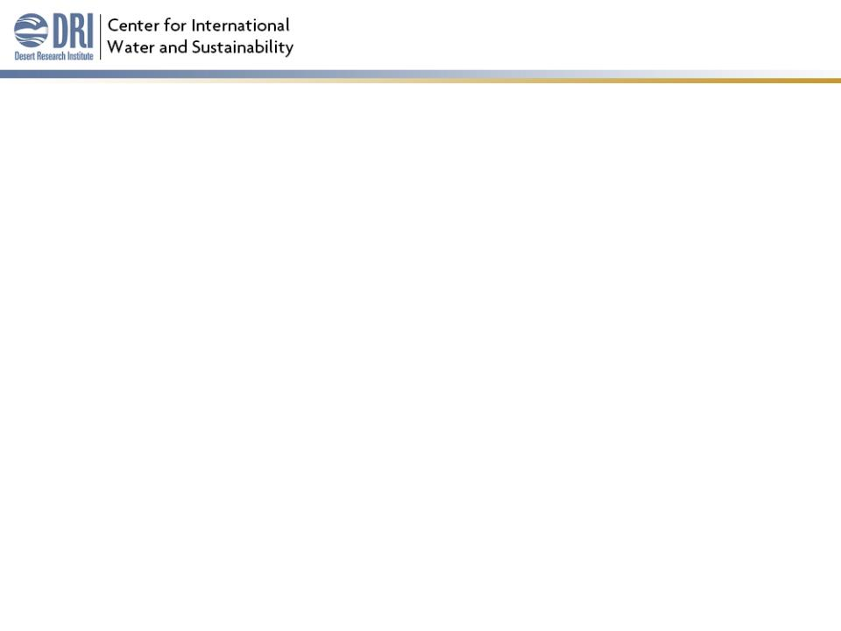
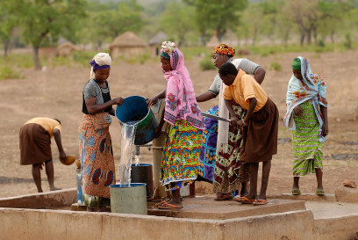
Problem
22 to 67% of water pumps break down after 1-2 years of completion, mostly in rural areas.
Failed systems have a direct impact on public health and waste of infrastructure investments – approximately $1.2 billion, cumulatively.
Small rural water services struggle due to weak governance, lack of qualified staff, and funding problems, among others.
Decentralization
Sources: RWSN, 2009; Chilton, 2014.

Slide 3
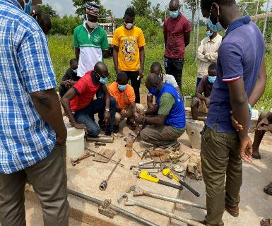
Hardware sustainability
Key functions of support to rural water systems include:
  Engaging community, school, HCF right from project assessment/design
  Setting up committees – WASH, O&M
  Training - technical, administrative (book keeping, savings, businesses, etc.), sanitation, hygiene
    Life-cycle costing, setting tariffs
  Spare parts; supply chain
  Establishing long-term post construction/sustainability plan
  Monitoring, Evaluation and Learning
  Establishing links with district-wide plan & external support groups such as state or private sector

Slide 4
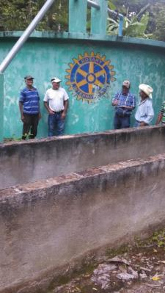
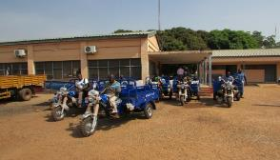
Long-term Sustainability Models
Community (based) Management
Implementing Organization Support to Local Governments
  Municipal Support Model
Centralized/Decentralized Government Support
Entrepreneurial Service Model
  Circuit Rider Program
  Mechanic Associations or Area Mechanics

Slide 5

Thank you!

