Slide 1

January 2013

Slide 2
Overview
iMembersDB is a semi-custom database-driven membership management system
Online Membership Management
Personalized Member Emailing
Club / Chapter affiliation
Committees
Event Calendar
Newsletters
Stories
Event Registrations with online payments
Membership Reports
Attendance
Dues Management
Subscription Management
Photo Gallery
Polls / Surveys
Forms processing
Website integration
Dashboard KPIs

Slide 3
What can I do?
Create and edit members’ profiles
Email members personalized messages using easy-to-use templates
Create and manage events, invite members, and have members register and pay online with credit cards
Invoice some or even all members for dues or fees with 10-12 clicks
Track who has paid (and who hasn’t) in your organization
Create and share stories that update your website automatically
Create name badges, table tents, or mailing labels of some or all of your membership
Create membership directories
Run and export membership data to familiar formats (Word, Excel)
Quickly create newsletters to send to your organization
And more….

Slide 4
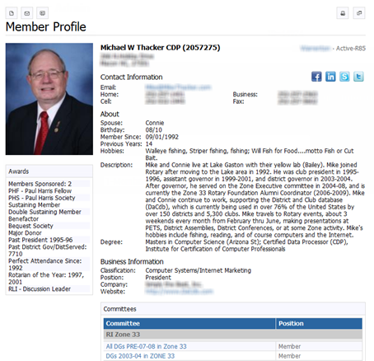
Member Profile
Customizable profile
Contact info:
  Phone
  Address
  Email
Description / Bio
Social media links
Committee participation
Events registered
Awards, achievements

Slide 5
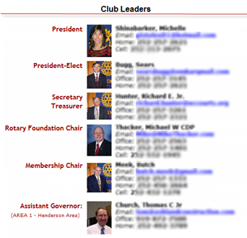
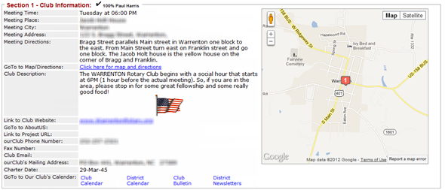
Clubs / Chapters
Members can be organized in a club, chapter or group
Members can be in one club – typically does not change
Officer / Leadership can be planned years in advance

Slide 6
Committees
Members can be on one or more committees (e.g., Board of Directors, Chapter Presidents)
Committees can be:
  Org Year-based (e.g. 2013)
  Perpetual
A committee can be grouped together
  Group “President” and “Secretary” committees
  Email the group
Committee leadership – year-to-year

Slide 7
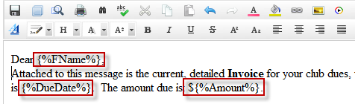
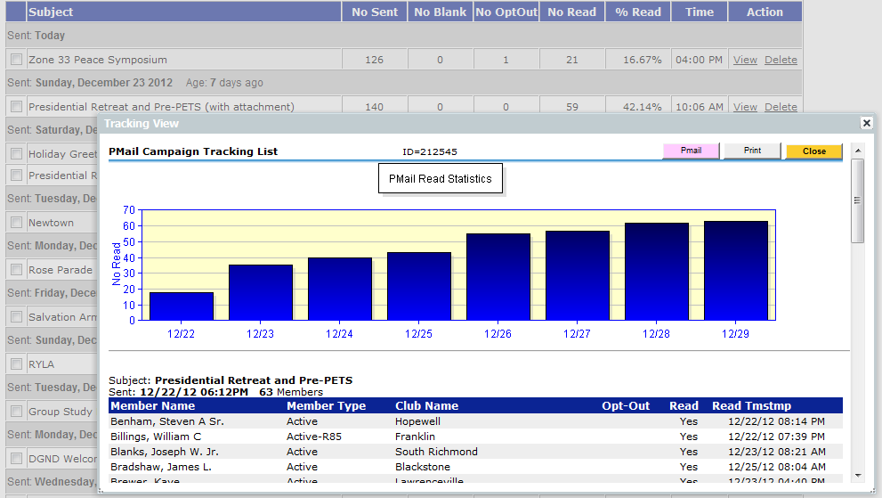
PMail (Personalized Email)
Customize personal messages to members in your club, event, committee or account
Create custom messages using the WYSIWYG HTML Editor
Easily create your own templates
Response tracking
Personal distribution groups
{%Fname%} – Nick Name or First Name if no Nick Name

Slide 8
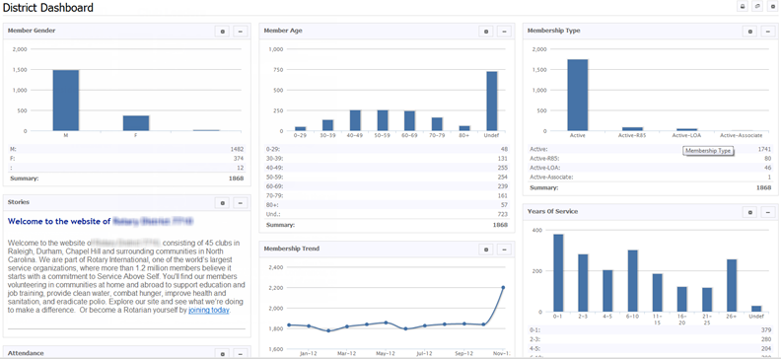
Dashboards
Account/District and Club/Chapter dashboards
Track and monitor your Org’s vital info / KPIs
Over 20+ drop in components (“widgets”)
Customizable – drop and drag positioning

Slide 9
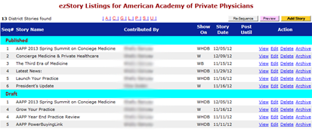

ezStory
This is a module that lets you create news items or stories that will automatically update your homepage when you complete them.
Make them as long or as short as you like
Include pictures and embed video
Drop and drag stories on your homepage
Set stories to appear on a certain date and cease to show on another
Include links to events or other pages with ease
Choose how much of the story to display without the reader clicking ‘Read More’

Slide 10
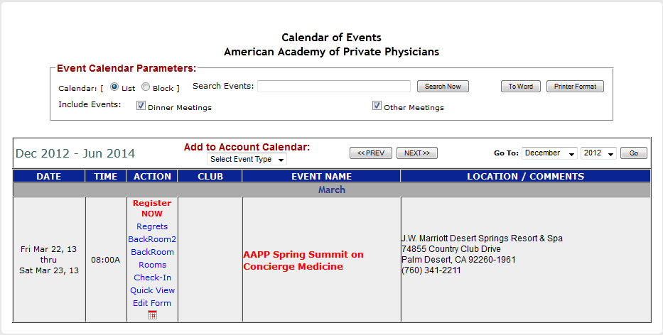
Event Calendar
Create and manage events for your organization.
Invite any and all members to attend
Track registrations through our easy-to-use event backroom
Include location, time, duration, occurrence
Ask questions of attendees about food, wine choices or seating preferences
Set online registration and include fees that you can track and pay online
Send reminders to members who haven’t registered (or who haven’t paid)
Collect “regrets” so you don’t re-mail members that indicated they cannot attend.
Automatically update your website with event changes

Slide 11
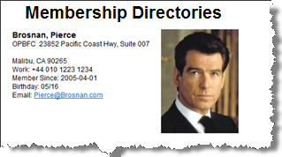

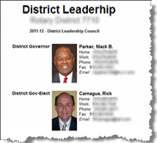
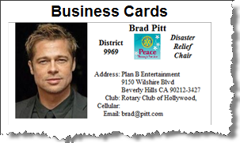
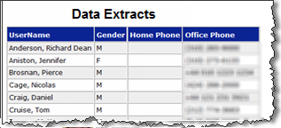
Reporting
Over 70 types of reports:
  Committee
  Club
  Account
  Events
Membership directories
  20+ formats available
  Custom options available
Event badges & tent cards
Data extracts to Excel/Word

Slide 12
Security
9 levels of member security control access, e.g.:
  Members – Level 1
  Club Officers – Level 4
  Account Admins– Level 7
Member data access based on security level and club-committee affiliation(s)
Password data encrypted
Firewall protected database
Regular database backups
Public and secured file storage
Transaction logging

Slide 13
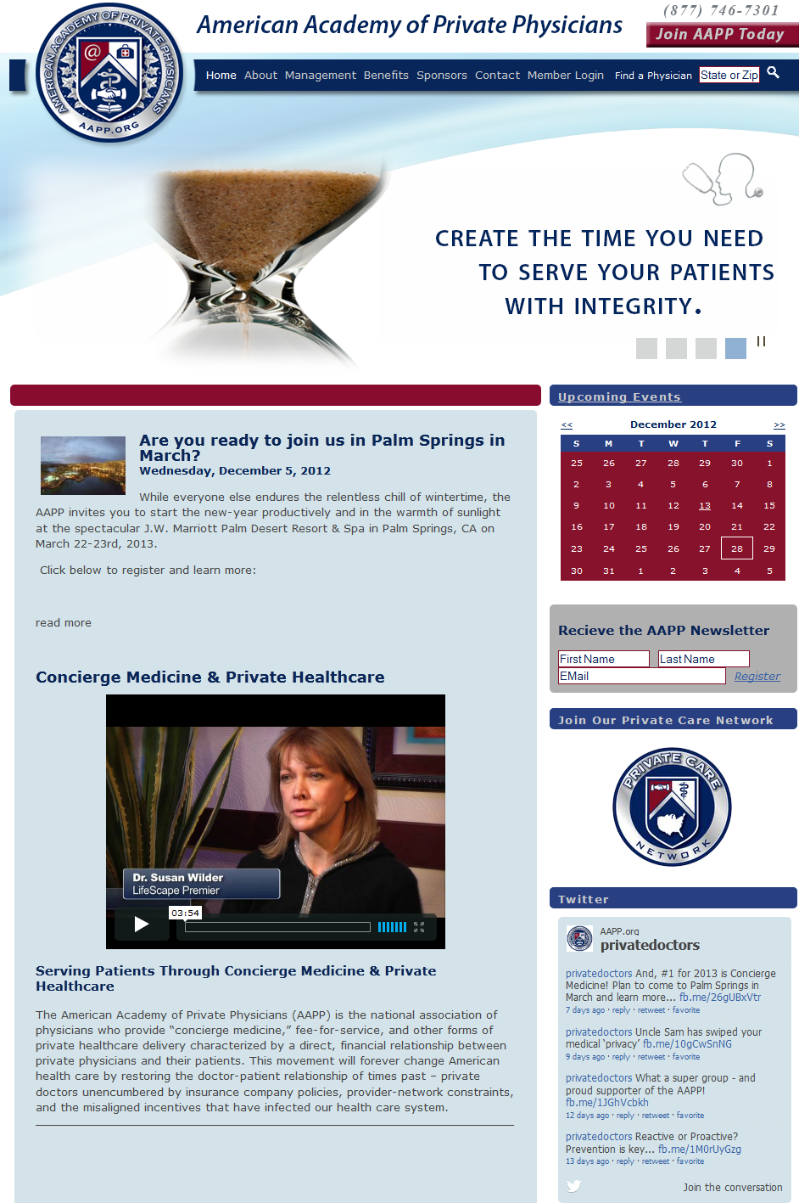
Architectural Relationship
Database
Members
Stories
Clubs &
Committees
Accounting
Dues
Events

Slide 14
Technology – Behind the Scenes
Adobe ColdFusion
Microsoft MS SQL
Microsoft IIS
jQuery / JavaScript
PHP
Over 1,000,000 lines of code
~10,000 pages of code
Over 9 years of development

Slide 15
Why iMembersDB?
iMembersDB can directly benefit your organization:
  You stay connected to your membership using PMail, ezStory and ezBulletin
  You set up events that members attend
  You have paid membership/dues/fees that need tracking and can be invoiced within 10-12 mouse clicks
  You want your website to update automatically whenever you create content
  You want your organization to run as efficiently as possible
We make it easy for you:
  No calling trees to support – 24x7 access
  Our semi-custom approach means we can tailor the system to meet your needs

Slide 16
Thank You!

