Slide 1

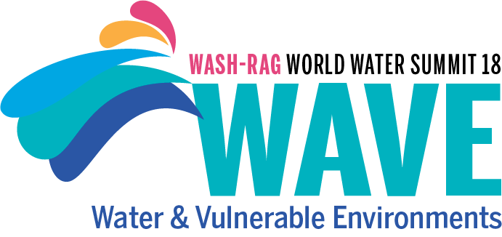


The Global Threat of Arsenic in Groundwater
Speaker: Yum Keung Ip
(RC Birkenhead, New Zealand

Slide 2



The Global Threat of Arsenic in Groundwater
The proposed Ground Water Arsenic Mitigation Humanitarian Program
DR YUM KEUNG IP
Taipei 13 JUNE 2026

Slide 3
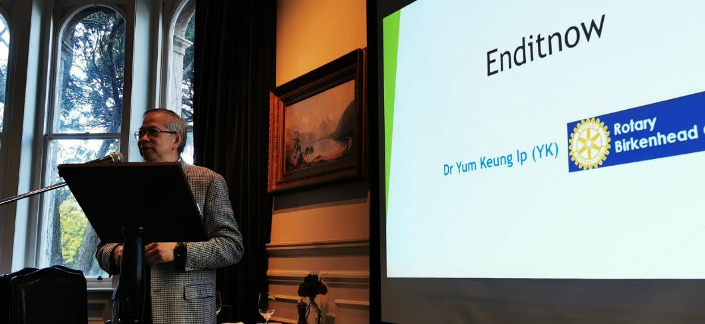
Presentation at Central Auckland Rotary Club on behalf of Birkenhead Rotary Club to appeal for donation to help eliminating rheumatic fever and chronic rheumatic heart disease in the Pacific Island countries. 21 Aug 2021

Slide 4
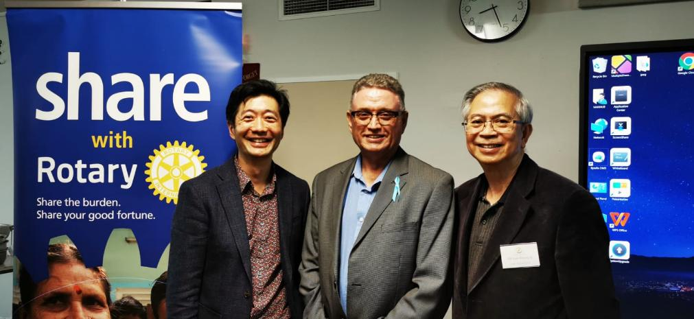
Birkenhead Rotary Presentation to local community: Prostate Cancer Update – with Prostate Cancer Foundation (PCF) of New Zealand and Mercy Radiology on 27 Jul 2022 – Theragnostics (^177Lu-PSMA-617) for late stage Prostate Cancer.

Slide 5
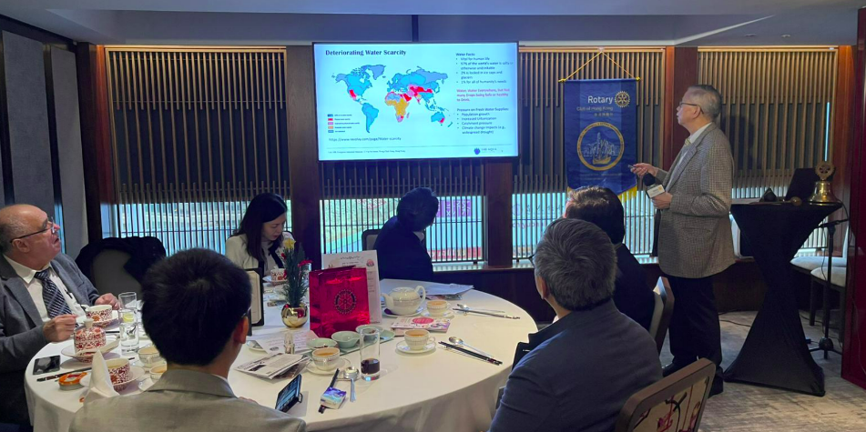
My presentation on 17 Dec 2024 at the Hong Kong Bankers Club for Rotary Club of Hong Kong established in 1930 (nick-named as the “Mother Club” of Rotary International District 3450, on Water Scarcity and Contamination with focus on Arsenic Ground Water Contamination being a major Global Public Health Threat.

Slide 6


The Global Threat of Arsenic in Ground Water
Global Threat of Ground Water Arsenic – accelerating global crisis like Water Scarcity
Health Impacts of Water Contaminants –
in General, & specific on ARSENIC
Water Treatment Trial Pilots (Thailand, Vietnam & Bangladesh) – First Phase
The Proposed Ground Water Arsenic Mitigation Humanitarian Program
Our CAT-Arsenic Technology

Slide 7
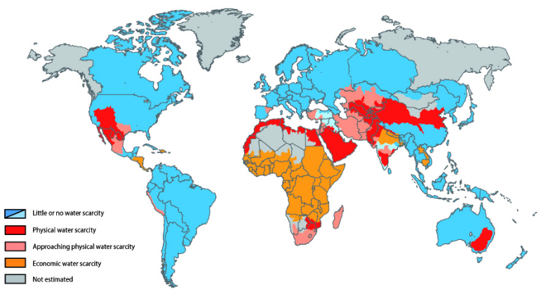
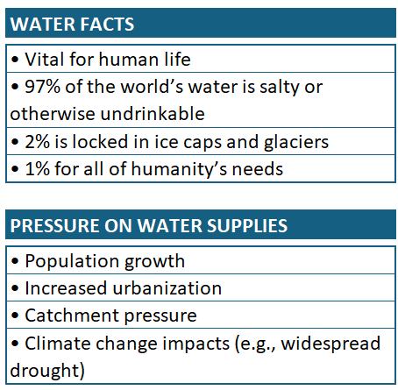

Water Scarcity: A Growing Global Crisis
https://www.revolvy.com/page/Water-scarcity
Unit 10B, Evergreen Industrial Mansion, 12 Yip Fat Street, Wong Chuk Hang, Hong Kong

Slide 8
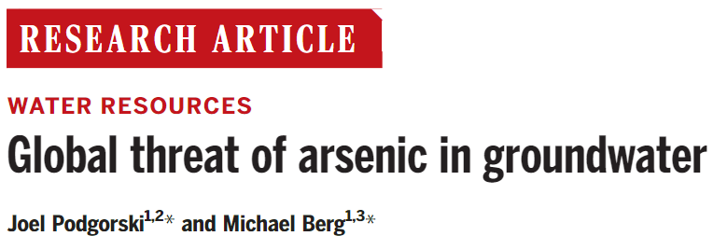
Naturally occurring arsenic in groundwater affects millions of people worldwide. We created a global prediction map of groundwater arsenic exceeding 10 micrograms per liter using a random forest machine-learning model based on 11 geospatial environmental parameters and more than 50,000 aggregated data points of measured groundwater arsenic concentration. Our global prediction map includes known arsenic-affected areas and previously undocumented areas of concern.
A global modelling study estimated that 94 million to 220 million people may be exposed to elevated arsenic concentrations in groundwater. Most of the risk is concentrated in Asia. Because groundwater is increasingly used to support growing populations and buffer against water scarcity due to changing climate, this work is important to raise awareness, identify areas for safe wells, and help prioritize testing.
J. Podgorski and M. Berg (2020). Global Threat of Arsenic in Groundwater. Science, 2020 May 22, Vol. 368(6493), 845-850. https://doi.org/10.1126/science.aba1510
Unit 10B, Evergreen Industrial Mansion, 12 Yip Fat Street, Wong Chuk Hang, Hong Kong

Slide 9
Key Facts from WHO Newsroom, 7 Dec 2022
WHO estimates that 140 million people in at least 70 countries have been drinking water containing arsenic at levels above 10 µg/L, or 10 ppb as established by WHO. This is consistent with the statistical modelling suggesting between 94 and 220 million people are at risk of exposure to elevated groundwater arsenic concentration.
Arsenic is highly toxic in its inorganic form.
Contaminated water used for drinking, food preparation and irrigation of food crops poses the greatest threat to public health from arsenic.
Long-term exposure to arsenic from drinking-water and food can cause cancer and skin lesions. It has also been associated with cardiovascular disease and diabetes. In utero and early childhood exposure has been linked to negative impacts on cognitive development and increased deaths in young adults.
The most important action in affected communities is the prevention of further exposure to arsenic by provision of a safe water supply.
World Health Organization (2022/12/07). Arsenic. World Health Organization. https://www.who.int/news-room/fact-sheets/detail/arsenic
Unit 10B, Evergreen Industrial Mansion, 12 Yip Fat Street, Wong Chuk Hang, Hong Kong

Slide 10
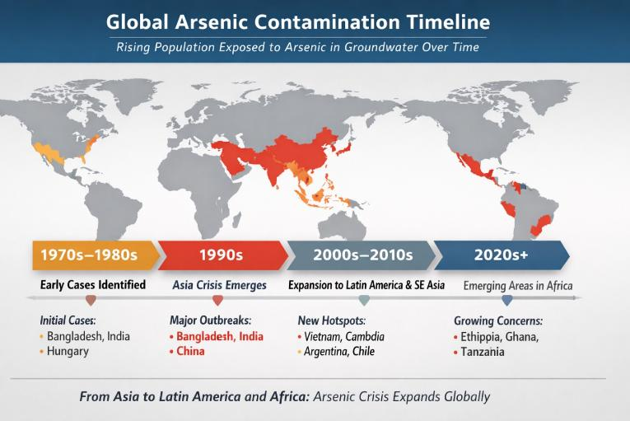
Global Spread of arsenic contamination in groundwater Regionally since 1970s, from early recognition in Asia and Europe to expansion in Latin America and now emerging hotspots in Africa.

Slide 11
Decade | Estimated Population Exposed | Key Regions | Notes
1970s–1980s | ~10–20 million | Bangladesh, India, Hungary | Early recognition; limited testing.
1990s | ~40–60 million | Bangladesh, India, China | Asia crisis emerges; WHO involvement.
2000s–2010s | ~100–150 million | South & Southeast Asia, Latin America | Expansion to Vietnam, Cambodia, Argentina, Chile.
2020s+ | ~200–300 million | Asia, Latin America, Africa | Africa emerging; climate-driven groundwater use increases.
Global Population Exposure by Decade

Slide 12
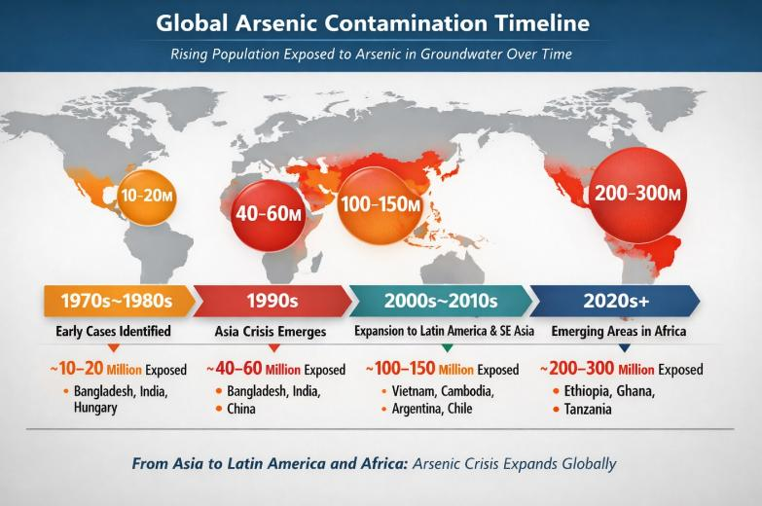
the enhanced timeline map with population exposure overlays you requested — it visually combines both the geographic spread and growth in affected population across decades

Slide 13
Projected Exposure Scenarios (2020s–2050) Scenario | Estimated Exposure by 2050 | Key Drivers | Notes
Moderate Climate Stress | ~350–400 million | Gradual groundwater expansion, partial mitigation success | Asia remains dominant; Africa and Latin America continue rising.
Severe Drought & Over‑Extraction | ~450–500 million | Deep aquifer drilling, reduced surface water, falling water table, redox shift, rising pH & ion competition, hydraulic effects, Limited testing | New hotspots likely in Sub‑Saharan Africa and Central Asia.
Aggressive Mitigation & Monitoring | ~200–250 million | Widespread well testing, alternative water sources | Decline possible if safe‑water programs scale globally.
Without intervention, exposure could double by mid‑century, driven by climate‑induced water scarcity and deeper well drilling.
Mitigation efforts—such as public awareness through education, community testing, rainwater harvesting, and aquifer management—could halve the risk.
Africa and South Asia will remain the most vulnerable regions under all scenarios.

Slide 14
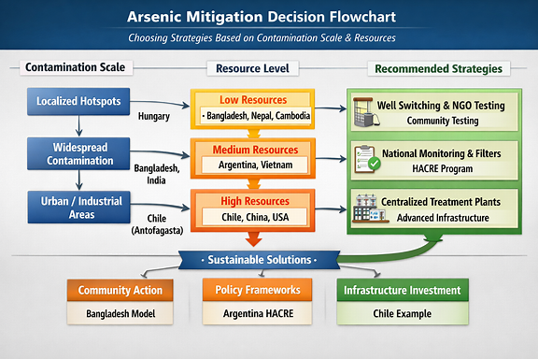
Country examples embedded directly into the decision boxes — to demonstrate how nations align with the strategies based on their contamination scale and resource levels

Slide 15
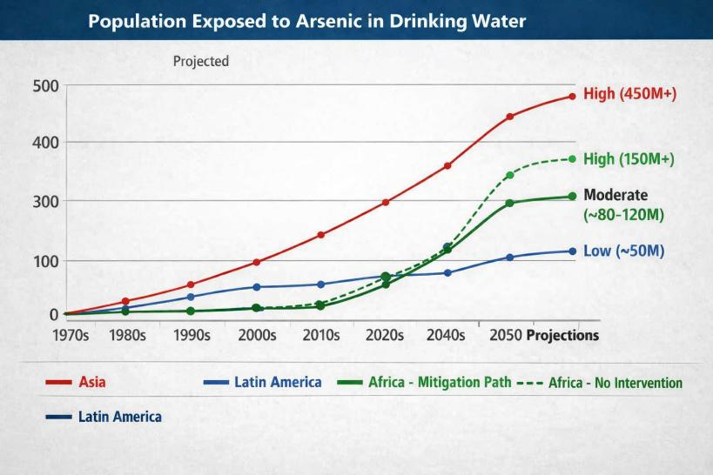
Africa’s exposure trajectory diverges sharply depending on intervention. The dashed “No Intervention” path shows instability and rising risk, while the solid mitigation path demonstrates how proactive action can halve exposure by 2050.

Slide 16
The Global Threat of Arsenic in Ground Water
Global Threat of Ground Water Threat – accelerating global crisis like Water Scarcity
Health Impacts of Water Contaminants –
in general, and specific on ARSENIC
Water Treatment Trial Pilots (Thailand, Vietnam & Bangladesh) – 1st Phase
The Proposed Ground Water Arsenic Mitigation Humanitarian Program – 2nd Phase
Our CAT-Arsenic Technology

Slide 17
Health Impacts of Water Contaminants
Waterborne Diseases: Contaminated water can cause diseases such as cholera, typhoid, dysentery, and hepatitis A. These diseases are often spread by pathogenic microorganisms present in polluted water.
Gastrointestinal Issues: Drinking contaminated water can lead to gastrointestinal problems like diarrhea, nausea, and vomiting.
Respiratory Disorders: Exposure to polluted water can worsen or cause respiratory disorders.
Skin Problems: Contaminated water can cause skin issues and dermatological problems.
Long-term Health Effects: Long-term exposure to contaminants such as arsenic can cause serious health effects, including cancer, skin lesions, cardiovascular disease, diabetes, and developmental impacts in children. ¹
Ensuring access to clean and safe drinking water is crucial for preventing these issues.
World Health Organization (2022/12/07). Arsenic. World Health Organization. https://www.who.int/news-room/fact-sheets/detail/arsenic
Unit 10B, Evergreen Industrial Mansion, 12 Yip Fat Street, Wong Chuk Hang, Hong Kong

Slide 18
Health Impacts of Contaminants of Emerging Concern (CECs)
CECs are chemicals or substances that have been detected in the environment and may pose risks to human health and ecosystems but are not yet regulated under current environmental laws.
Per and polyfluorinated alkyl chemicals (PFAS) and liquid crystal monomers (LCMs): These are so called “forever chemicals”, persistent in our environment up to thousands of years. They cause many cancers and disrupt our endocrine and reproductive system.
Pharmaceuticals and Personal Care Products (PPCPs): These include medications, cosmetics, and hygiene products that can enter water bodies through wastewater.
Endocrine Disruptors: Chemicals that can interfere with the endocrine system, affecting hormone function and potentially leading to reproductive and developmental issues.
Microplastics and nanoplastics: Tiny plastic particles that can be ingested through drinking water and by aquatic organisms, potentially entering the food chain and affecting human health.
Antibiotics and Antimicrobials: These can promote antibiotic resistance in bacteria, posing a significant public health risk.
Industrial Chemicals: Substances used in manufacturing processes that can contaminate water sources.
Contaminants of emerging concern show that “safe water” should not only mean clear water. This presentation focuses on arsenic because it is one of the most serious groundwater contaminants affecting vulnerable communities.
Unit 10B, Evergreen Industrial Mansion, 12 Yip Fat Street, Wong Chuk Hang, Hong Kong

Slide 19
Arsenic toxicity in relation to concentration in drinking water
The WHO (2022) provisional guideline value for arsenic in drinking water is 10 µg/L, or 10 ppb. This is a common enforceable regulatory benchmark, but it is not a zero-risk level.* It is also known as the Maximum Contaminant Level (MCL).
Long term exposure may cause thickening and discoloration of the skin, keratosis, numbness in hands and feet, melanosis, heart and circulatory system disease, respiratory system disease, mental illness such as depression and liver, kidney, lung and skin cancer. In children, it can impact neurodevelopment & cognition, growth & immune function, as well as pregnancy & infant outcome on top of the skin & cancer risk in later life.
Arsenic can act as a co-carcinogen by blocking DNA repair at levels lower than 0.010 mg/l:
  California’s Public Health Goal since 2004 (PWD (2025)**) is 0.004 µg/L, showing that health-risk targets should be far lower than compliance standards. It is also known as Maximum Contaminant Level Goal (MCLG).
Above 0.015 mg per liter the arsenic accumulates in the human body. Cancer may be the most serious and final risk but is just one aspect of health risks and social problems caused by arsenic
WHO estimates around 140 million people in at least 70 countries have been exposed to drinking water above 10 µg/L. A global modelling study estimated 94 million to 220 million people may be exposed to elevated groundwater arsenic.
*World Health Organization (2022/12/07). Arsenic. World Health Organization. https://www.who.int/news-room/fact-sheets/detail/arsenic
** Palmdale Water District (2025). Public Health Goal. http://www.palmdalewater.org/wp-content/uploads/2025/06/2025_PHG_Report_Final_Web.pdf
Unit 10B, Evergreen Industrial Mansion, 12 Yip Fat Street, Wong Chuk Hang, Hong Kong

Slide 20
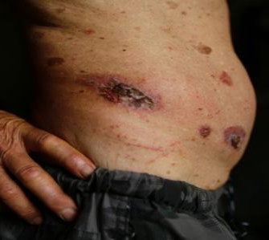
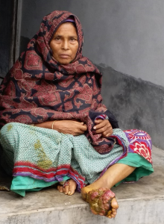
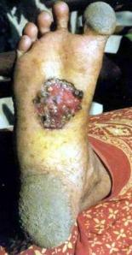
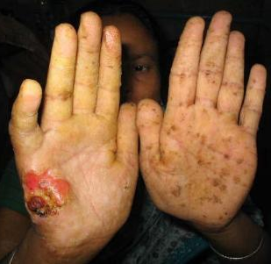
Health Effects of Arsenic Contamination
Images: Arsenic poisoning induced specific cancer through genetic defect from arsenic toxicity.
Unit 10B, Evergreen Industrial Mansion, 12 Yip Fat Street, Wong Chuk Hang, Hong Kong

Slide 21
The Global Threat of Arsenic in Ground Water
Global Threat of Ground Water Arsenic – accelerating global crisis like Water Scarcity
Health Impacts of Water Contaminants –
in general, and specific on ARSENIC
Water Treatment Trial Pilots (Thailand, Vietnam & Bangladesh) – 1st Phase
The proposed Ground Water Arsenic Mitigation Humanitarian Program – 2nd Phase
Our CAT-Arsenic Technology

Slide 22

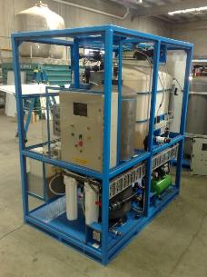
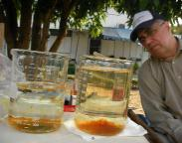
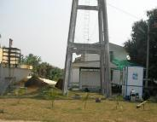
Kamphaeng Saen Hospital and Kanchanaburi, Thailand
Arsenic removal to WHO standards
All results showed ‘non –detectable’ levels of arsenic at laboratory method resolution of 0.0001mg/l.
These results are promising and should be supported by independent laboratory records, operating data, and long-term monitoring.
8 other water treatment systems were previously tested at the Kamphaeng Saen site for arsenic removal without success.
Parameter | Raw 1 | Raw 2 | Treated S1 | Treated S2 | Treated S3 | Treated S4 | Treated S5 | Treated S6 | ADWG
Arsenic mg/l (Kamphaeng Saen, Thailand) | 0.139 | 0.1434 | ND | ND | ND | ND | ND | ND | 0.010
Arsenic mg/l (Kanchanaburi, Thailand) | 0.38 | 0.4857 | ND | ND | ND | ND | ND | ND | 0.010
World Health Organization-Drinking Water Guidelines: As < 10 µg/l ; ND = Not detectable at limit of reporting of 0.1 µg/L
World Health Organization (2022). Guidelines for drinking-water quality. 4th edition. https://iris.who.int/server/api/core/bitstreams/69c17edd-ee26-425b-9d34-33799377e886/content
Unit 10B, Evergreen Industrial Mansion, 12 Yip Fat Street, Wong Chuk Hang, Hong Kong

Slide 23
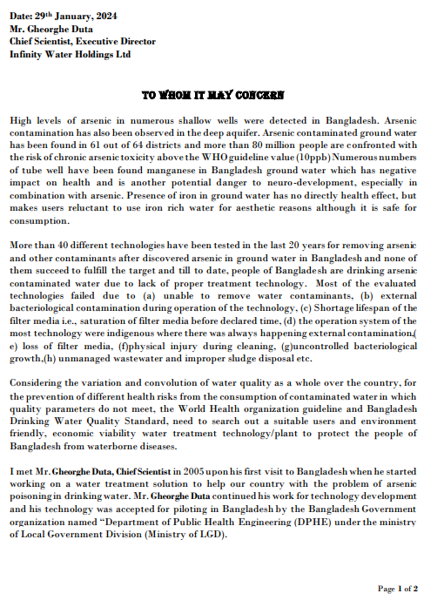
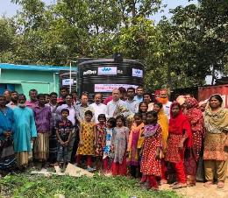
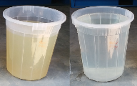
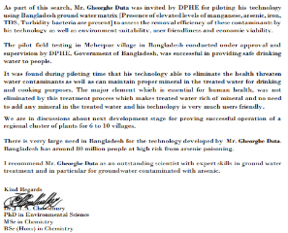
Drinking water at Meherpur District (Southern Bangladesh)
Capacity of Plant : 15,000 L/day
The district has been suffering from high levels of arsenic in local groundwater, resulting in cancer, skin lesions, cardiovascular diseases, and other health impacts. 43,000 people died from arsenic poisoning every year.
The government has not yet found an effective clean-water solution before Catalytic Advanced Treatment.
The trial suggests that CAT-Arsenic treatment may reduce exposure risk by lowering arsenic levels in drinking water.
Reference letter on 29th Jan 2024 attached.
Parameter | Unit | HK Criteria* | Untreated | Treated
Arsenic | mg/L | 0.01 | 0.178 | 0.003 – 0.007
Manganese | mg/L | N/A** | 0.98 | 0.04
Iron | mg/L | 0.3 | 6.34 | 0.08
*Made reference to Quality Water Supply Scheme for Buildings – Fresh Water (Plus) & Hong Kong Drinking Water Standard
**Manganese currently not included in HKDWS, reference from The 2022 Annual Report on Drinking Water Quality in Hong Kong
Human Rights Watch. (2016). Nepotism and Neglect: The Failing Response to Arsenic in the Drinking Water of Bangladesh’s Rural Poor. https://www.hrw.org/report/2016/04/06/nepotism-and-neglect/failing-response-arsenic-drinking-water-bangladeshs-rural
Unit 10B, Evergreen Industrial Mansion, 12 Yip Fat Street, Wong Chuk Hang, Hong Kong

Slide 24

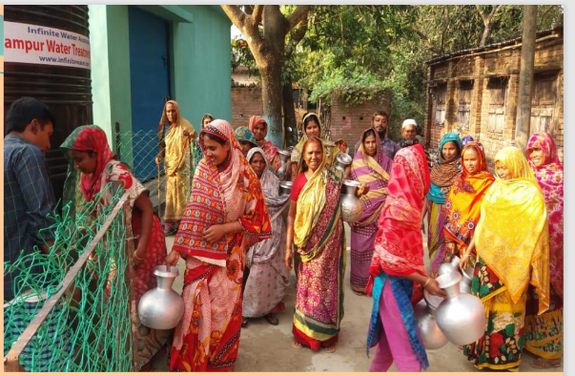
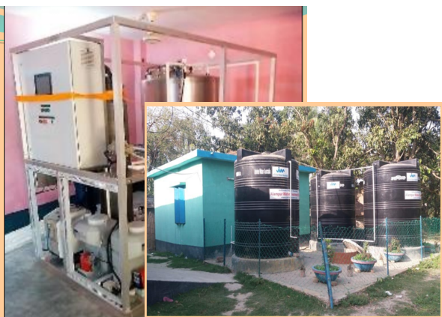
Arsenic Removal WTP
UN Humanitarian Project Proposal
for Healthy Drinking Water
  The CAT process delivers innovative
  potable and waste water treatment solutions with Sustainability, Health & Energy focus.

Slide 25
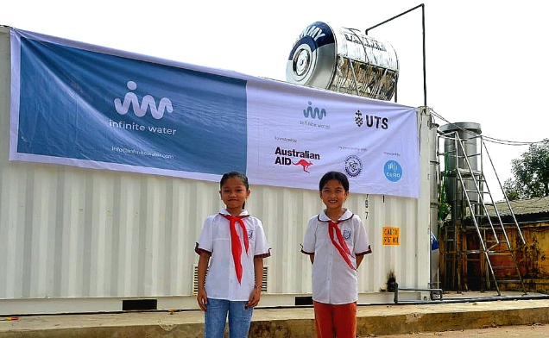
Groundwater Treatment Plant for Tien Phong Primary School, Vietnam
A humanitarian project with the University of Technology Sydney (UTS), Australian Aid, and Vietnam academy of Science and Technology, to design, install, commission, and operate a fit-for-purpose arsenic mitigation ground water treatment plant for a primary school in Vietnam. The extremely high concentration of arsenic (0.55mg/L), iron (31mg/L), and ammonia 18mg/L) were treated well below the drinking water standard (<0.01, <0.3. and <0.3 respectively)
Most importantly, the plant will improve the health and well-being of the school children of Tien Phong, by removing the arsenic and other contaminants and delivering safe, clean, reliable potable water compliant with Vietnamese drinking water guidelines.
The plant has been designed to be simple, cost-effective, very energy efficient, and easy to operate, enabling viable deployment of decentralized systems across Vietnam. Local operators will be trained to run the plant once the pilot is completed, providing a viable, self-sustainable solution.
SHE Aqua will also work with UTS to demonstrate a remote data management platform integrated into the water treatment plant pilot, providing autonomous control on an IoT platform.
Unit 10B, Evergreen Industrial Mansion, 12 Yip Fat Street, Wong Chuk Hang, Hong Kong

Slide 26
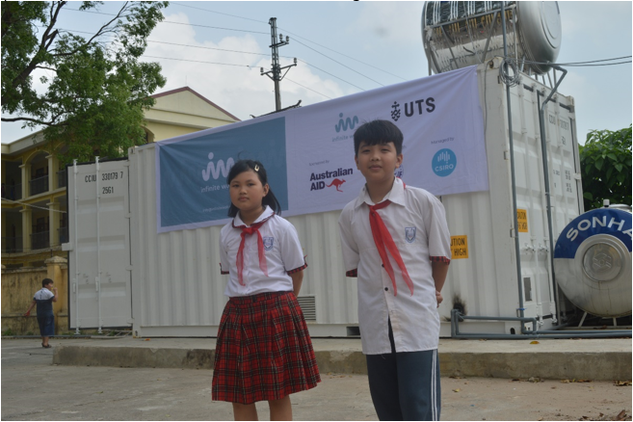
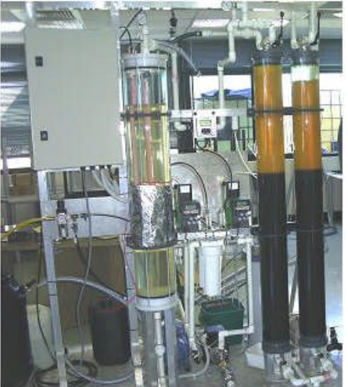
With the potentially cost-effective SHE AQUA arsenic treatment available, it can create new hope for millions in future generations by helping chronic arsenic poisoning patients avoid further exposure from contaminated water sources.
Experimental stand - 2006
Unit 10B, Evergreen Industrial Mansion, 12 Yip Fat Street, Wong Chuk Hang, Hong Kong

Slide 27
The Global Threat of Arsenic in Ground Water
Global Threat of Ground Water Threat – accelerating global crisis like Water Scarcity
Health Impacts of Water Contaminants –
in general, and specific on ARSENIC
Water Treatment Trial Pilots (Thailand, Vietnam & Bangladesh) – 1st Phase
The Proposed Ground Water Arsenic Mitigation Humanitarian Program – 2nd Phase Pilot
Our CAT-Arsenic Technology

Slide 28
Proposed Second Phase Pilot Field Testing
Results from the First Phase Trial
The technologies used could apply to household, village and large communities with arsenic level after treatment to well below the recommended WHO and ADWG standard of <0.01mg/L.
There were management and maintenance issues making household level solution fail social, technical and performance viability
Large scale systems fail typically economic viability and in part technical viability due to added cost of distribution network and maintenance difficulties.
The Second Phase Pilot Field Testing for the trial on Effective Management and Planning
Technical effectiveness of the arsenic mitigation plant was demonstrated in the first phase pilots in Thailand, Bangladesh, and Vietnam.
We are planning a second phase trial to collect data on monitoring, control, maintenance, servicing, and social aspects.
New designs will be added to the automation control and communication system with power supply, uninterrupted power supply.
With the limited resources, a moderate scale system of 10 treatment plants to be commissioned in 10 schools in the same region of Bangladesh in collaboration with the Ministry of Education.
This will be a step to design and plan the future mass project for nationwide or internationally scale.
Unit 10B, Evergreen Industrial Mansion, 12 Yip Fat Street, Wong Chuk Hang, Hong Kong

Slide 29
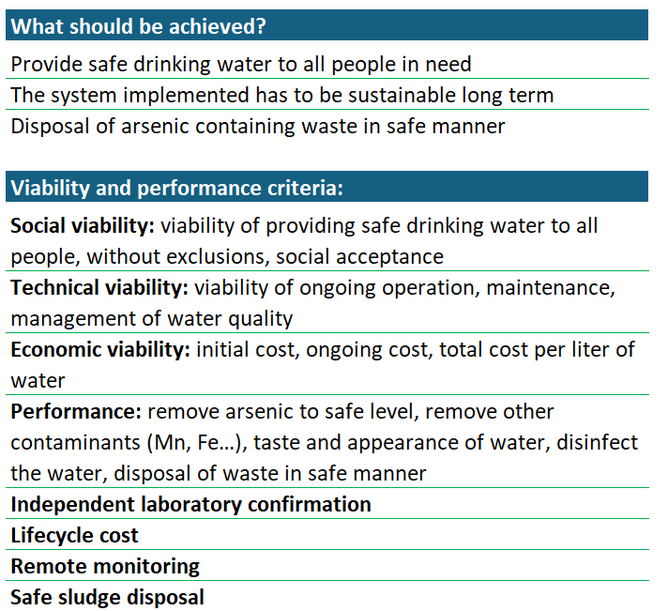
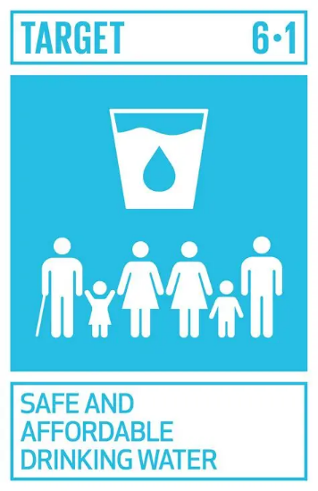
Comparison Criteria for the Phase II Trial
Unit 10B, Evergreen Industrial Mansion, 12 Yip Fat Street, Wong Chuk Hang, Hong Kong

Slide 30
Humanitarian Project on Arsenic Poisoning
THE URGENT NEED
Arsenic poisoning from drinking water in Bangladesh has emerged as one of the world's most pressing humanitarian crises. According to Chemists without Borders, an international organization dedicated to addressing arsenic issues in Bangladesh, 35-77 million people out of the country's population of 150 million are at risk due to arsenic-contaminated water. Shockingly, it is estimated that between 1-5 million children could face death from arsenicosis by the year 2030.
The UN Sustainable Development Goals (SDG) for water prioritize universal access to drinking water and the sustainable management of water resources to ensure that no one is left behind. In SDG 6.1 represents greater focus on the safety of drinking water in seeking “By 2030, achieve universal and equitable access to safe and affordable drinking water for all.”
Periodic Monitoring and mapping – target <10 ppb (0.01mg/kg) reducing drinking water arsenic exposure.
Establish arsenic removal systems (treatment at source and/or household).
Continual collaboration with Government, NGO, or other research institutes plus local engineering / technical support in commissioning, maintenance & servicing.
Smith et al. (2000). Contamination of drinking-water by arsenic in Bangladesh. Bulletin of the World Health Organization, 2000, 78(9), 1093-1103. https://iris.who.int/server/api/core/bitstreams/db157677-fc42-4ed4-bac7-9eb0a026e668/content
Human Rights Watch. (2016). Nepotism and Neglect: The Failing Response to Arsenic in the Drinking Water of Bangladesh’s Rural Poor. https://www.hrw.org/report/2016/04/06/nepotism-and-neglect/failing-response-arsenic-drinking-water-bangladeshs-rural
United Nations Children’s Fund & World Health Organization. (2018). Arsenic primer: Guidance on the investigation and mitigation of arsenic contamination. https://www.unicef.org/media/91296/file/UNICEF-WHO-Arsenic-Primer.pdf
Unit 10B, Evergreen Industrial Mansion, 12 Yip Fat Street, Wong Chuk Hang, Hong Kong

Slide 31
Project Proposal
Set-up a JV company or charitable trust to lodge Arsenic Removal Water Treatment Plant (WTP-AS) patent for IP protection and project roll out sustainably.
It has improvement based upon the successful design by Chief Scientist Gheorghe Duta since 2003 with the catalytic material to address arsenic removal using co-precipitation with iron, manganese, and aluminium.
On 17 Nov 2005, the first formal test for confirmation of arsenic removal was conducted under Aid Development Engineering. The results demonstrated successful removal of arsenic as well as drinking water compliant disinfection. Arsenic removal pilot plants were installed in Thailand, Bangladesh and Vietnam. A pilot field testing, in collaboration with University of Technology Sydney, is in operation (UTS) in Vietnam. The available results indicate successfully removing high concentration of ammonia and iron in the ground water, at the same time. (1st Phase Pilots)
The available results indicate that the product can generate healthy potable water with arsenic levels below the WHO guideline and near non-detectable levels, subject to further pilot testing and independent verification.
The next move will put in more pilot plants for further trials before quantity production and marketing and sales. Plants will need local operational support and maintenance support. (2nd Phase Pilots trial with remote IoT access at 3-7 selected countries for data collection and analysis, pathing the pathway for global roll out)
The raised capital, research grant or donations will be used to further develop the product, patent application, quantity production, and marketing & sales. We shall have further discussion about the partnership, shareholder agreement, and business plan to support a financially sustainable project for the operation and medical research in the next 20-40 years.
Unit 10B, Evergreen Industrial Mansion, 12 Yip Fat Street, Wong Chuk Hang, Hong Kong

Slide 32
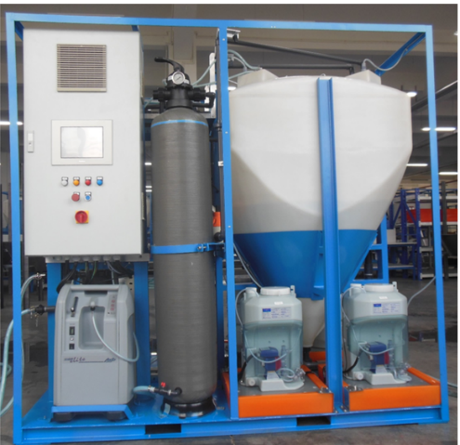
Modular Arsenic Removal Plant for
Bangladesh 2nd phase pilot field testing
The current specification
For small communities ,
capacity of up to 10,000 L/day
Single phase GPO power outlet
Power consumption: 1 kWh
Height: 2200mm
Length: 2300mm
Width: 1400
Weight: 700kg
Transport: 4 plants in one 20’HC ISO container
IoT system for remote data collection, monitoring & control
Optional solar power system with battery storage
Optional upgrade for bigger community need

Slide 33
The Global Threat of Arsenic in Ground Water
Global Threat of Ground Water Arsenic – accelerating global crisis like Water Scarcity
Health Impacts of Water Contaminants –
in general, and specific on ARSENIC
Water Treatment Trial Pilots (Thailand, Vietnam & Bangladesh) – 1st Phase
The proposed Ground Water Arsenic Mitigation Humanitarian Program – 2nd Phase
Our CAT-Arsenic Technology
Conclusion

Slide 34
Conventional Arsenic Mitigation Technologies
Coagulation, precipitation, filtration, adsorption, reverse osmosis (RO)
Pre-treatment is needed for removal of suspended solids, colloidal matter and scale forming substances. RO membranes have very fine pores through which water is forced under pressure. The large ions, like oxidized arsenic, do not pass through and are discharged with the waste stream called concentrate.
Sludge disposal
Arsenic is concentrated in waste streams: sludge from clarification, backwash spent water from filtration and concentrate from RO separation. Sludge may be dewatered and disposed to special disposal sites, added to concrete and added to material for producing bricks.
One of the technologies of interest applied in India is bioremediation. The wastewater is stored in a concrete tank where bacteria and plants absorb the arsenic. Then the sludge and plants are burned, and the ash is added to bricks.
Attention: When burning bricks or the plants containing arsenic up to 30% could vaporize and spreads into the environment.
Unit 10B, Evergreen Industrial Mansion, 12 Yip Fat Street, Wong Chuk Hang, Hong Kong

Slide 35
Brief Description of Technologies
Coagulation, precipitation, filtration, adsorption
Adsorption of arsenic is based on attraction to the surface of adsorbent materials. Oxidized arsenic has negative electrical charge and is attracted to positively charged sites on the surface of materials such as: Granular Ferric Hydroxide (GFH), Activated Alumina (AA) and Cerium oxide. To be efficient, pre- treatment has to be done for removal of suspended solids, colloidal matter and sometimes removal of competing ions.
Adsorption alone may be effectively used as retrofit to existing plants to achieve compliant level of arsenic removal. This is the case of large use of GFH filters in US after the Maximum Contaminant Level for arsenic in drinking water changed from 0.050 mg/l to 0.010 mg/l.
In situ immobilization of arsenic
In situ adsorption of arsenic is based on oxidation-adsorption using chemicals or oxygenation with air in combination with bacterial activity. Applied already in India is the Subterranean Arsenic Removal (SAR). Two groundwater wells are setup at some distance depending on permeability of the aquifer. The water is pumped out of one well, oxygenated and degassed in a tank, then re-injected into the second well. Underground, the water travels slowly between the two wells. Initial phase of oxidation and adsorption of arsenic may take 2 months. After that, water from one well is safe to be pumped for use as drinking water. Wells are switched between injection and supply, after some time.
Unit 10B, Evergreen Industrial Mansion, 12 Yip Fat Street, Wong Chuk Hang, Hong Kong

Slide 36
OUR TECHNOLOGY: CAT-ARSENIC
Conditioning
Oxygenation, Iron, Potassium Permanganate, Disinfectant…
Filtration - Catalytic Advanced Treatment
The process takes place in 2 physical subassemblies of the plant: Conditioning module and Catalytic Advanced Treatment (CAT) module.
Conditioning module is used to remove suspended solids, colloidal matter and prepare the water for final CAT stage. For arsenic removal, the arsenic is oxidized, then an iron salt is added for coagulation, co-precipitation of arsenic with iron and to provide reactive metal for the CAT module. Large part of arsenic is contained in the sludge discharged from Conditioning module.
CAT module provides polishing stage of co-precipitation of arsenic with iron and other metals. Reactions are based on iron chemistry. Arsenic is contained in the backwash spent water from the CAT reactor. In addition, to arsenic removal the CAT module provides very high-performance disinfection.
Unit 10B, Evergreen Industrial Mansion, 12 Yip Fat Street, Wong Chuk Hang, Hong Kong

Slide 37
COMPARISON OF TECHNOLOGIES
Technology | Performance | Technical viability | Economic viability | Social viability
SHE AQUA CAT - ARSENIC | As<1 ppb economically achievable Disinfection Complete water treatment | Stable process Simple operation Robust system | Low operational cost Low energy consumption Low cost treated water | Low-cost safe water for any size community Remote monitoring prevents problems
ADSORPTION | As< 10 ppb achieved at higher cost Disinfection: to be added Limited by TDS and competing ions | Unstable process, degree of As removal varies during use Simple operation Requires frequent change of adsorbent | Medium operational cost Low energy consumption Medium cost of treated water | Could not be applied to all area could cause conflict. Cost of water is relatively high and some people may be excluded from supply
IN SITU TREATMENT | As < 10 ppb economically achieved Limited by aquifer and water characteristics Process not stable Disinfection: to be added | Simple process The process is simple but equipment is not Requires specialist attention | Low operational cost Medium energy consumption Low to medium cost of treated water | Could not be applied to all areas. Limited capacity and number of people supplied
REVERSE OSMOSIS | As < 10 ppb achievable at high cost. Not removing As (III) Fe, Mn, Al in feed water have to be lower than drinking water limits | High tech operation Not robust system Produces large volume of wastewater | High operational cost High energy consumption High cost of treated water | High cost of water could lead to social exclusion. Difficult to accept due to operational complexity
Unit 10B, Evergreen Industrial Mansion, 12 Yip Fat Street, Wong Chuk Hang, Hong Kong

Slide 38
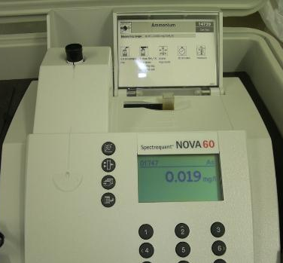
OUR TECHNOLOGY: SLUDGE TREATMENT
SLUDGE
THICKENING
TANK
TO RAW WATER
BUFFER TANK
PUMP
SLUDGE
BAGS
ARSENIC IN SEPARATED WATER 0.019 mg/l
After decanting, sludge is treated for thickening and encapsulation of precipitate. If the sludge is dried (recommended) will pass the TCLP test. TCLP test is the most reliable indicator of stability of the sludge in the environment and of arsenic dissolution risk.
Unit 10B, Evergreen Industrial Mansion, 12 Yip Fat Street, Wong Chuk Hang, Hong Kong

Slide 39
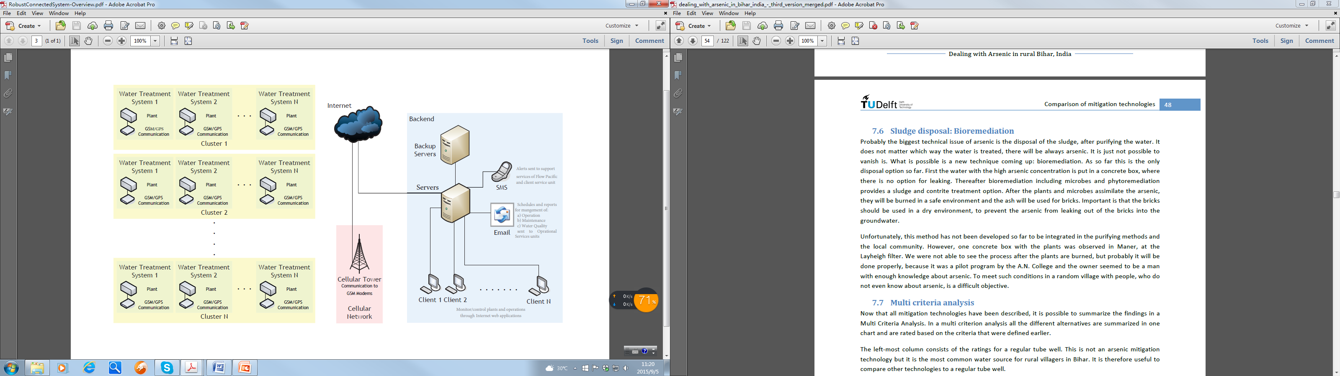
OUR TECHNOLOGY: ROBUST CONNECTED SYSTEM (OPTIONAL)
Plant design: Space probe approach using Programmable Automation Controllers system. Plants operate well even if communication is lost.
Backend knowledge-based system for management of operations, maintenance and water quality.
Unit 10B, Evergreen Industrial Mansion, 12 Yip Fat Street, Wong Chuk Hang, Hong Kong

Slide 40
REFERENCES
J. Podgorski and M. Berg (2020). Global Threat of Arsenic in Groundwater. Science, 2020 May 22, Vol. 368(6493), 845-850. https://doi.org/10.1126/science.aba1510
World Health Organization (2022/12/07). Arsenic. World Health Organization. https://www.who.int/news-room/fact-sheets/detail/arsenic
Palmdale Water District (2025). Public Health Goal. http://www.palmdalewater.org/wp-content/uploads/2025/06/2025_PHG_Report_Final_Web.pdf
World Health Organization (2022). Guidelines for drinking-water quality. 4th edition. https://iris.who.int/server/api/core/bitstreams/69c17edd-ee26-425b-9d34-33799377e886/content
Human Rights Watch. (2016). Nepotism and Neglect: The Failing Response to Arsenic in the Drinking Water of Bangladesh’s Rural Poor. https://www.hrw.org/report/2016/04/06/nepotism-and-neglect/failing-response-arsenic-drinking-water-bangladeshs-rural
Smith, A. H., Lingas, E. O., & Rahman, M. (2000). Contamination of drinking-water by arsenic in Bangladesh: A public health emergency. Bulletin of the World Health Organization, 78(9), 1093–1103. https://iris.who.int/server/api/core/bitstreams/db157677-fc42-4ed4-bac7-9eb0a026e668/content
United Nations Children’s Fund & World Health Organization. (2018). Arsenic primer: Guidance on the investigation and mitigation of arsenic contamination. https://www.unicef.org/media/91296/file/UNICEF-WHO-Arsenic-Primer.pdf
A. Mukherjee et al. (2024). Arsenic and other geogenic contaminants in global groundwater. Nature, Nature Reviews Earth & Environment, 2024, vol. 5, 312-328. https://www.nature.com/articles/s43017-024-00519-z
Acknowledgement: Some presentation content, data visualization and mechanistic synthesis prepared using Microsoft Copilot (AI) for educational purpose.
Unit 10B, Evergreen Industrial Mansion, 12 Yip Fat Street, Wong Chuk Hang, Hong Kong

Slide 41

Conclusion – The next after POLIO eradication
Globally, between 94 million and 220 million people are currently exposed to unsafe levels of arsenic in groundwater, with the majority in Asia, and broader estimates suggest up to 300–500 million people are at risk when other geogenic contaminants are included. Evidence shows the affected population has been rising due to increased groundwater reliance, climate-driven water scarcity, and land-use changes.
(A. Mukherjee et al. (2024). Arsenic and other geogenic contaminants in global groundwater. Nature, Nature Reviews Earth & Environment, 2024, vol. 5, 312-328. https://www.nature.com/articles/s43017-024-00519-z)
Arsenic contamination is a critical and rapidly escalating global challenge disproportionately affecting vulnerable populations if not addressed now,.
It requires a mix of technology, government policy, education, diagnostic & therapeutic research (e.g. herbal medicine, gene therapy), and international collaboration to ensure safe water and food for all.
After eradicating POLIO, what’s the next global project to stop hundreds of millions of people getting chronic ill health, disability and death.
ACTION NOW will save Millions of life and socio-economic cost in future.

Slide 42

Thank you.
Q & A
Dr Yum Keung IP
Chairman
SHE Aqua Technology Co. Ltd.

