Slide 1




Safe Water in the Most Vulnerable Environments: Lessons from Communities at the Margins
Speaker: Kaloy Manlupig
Volunteer CEO Safe Water for Every Child, Philippines

Slide 2
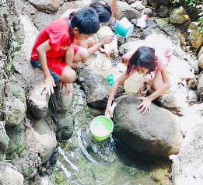
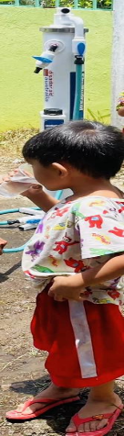
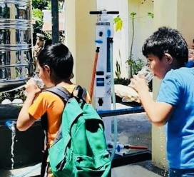
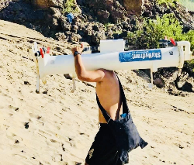
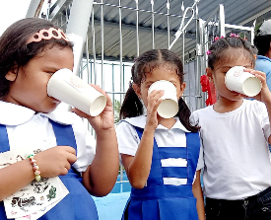

SAFE WATER IN THE MOST VULNERABLE ENVIRONMENTS
LESSONS FROM COMMUNITIES AT THE MARGINS
CHARLITO “KALOY” Z. MANLUPIG
Volunteer CEO
Safe Water For Every Child – Philippines (SWFEC-Ph)

Slide 3
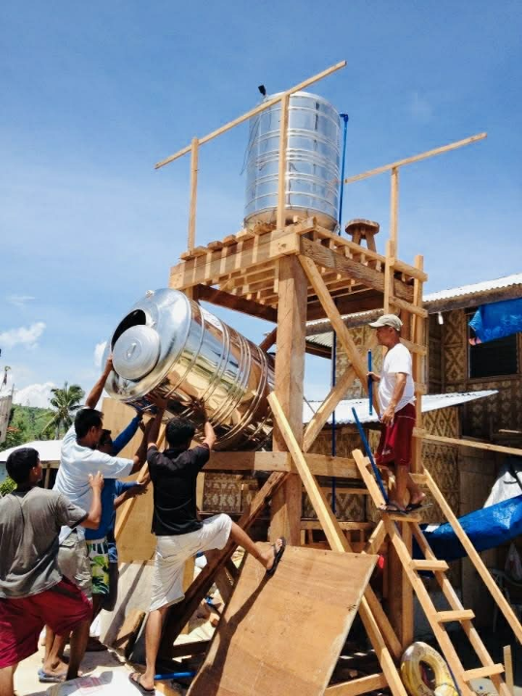

Our Journey Towards the Fulfilment of Our Mission.
Safe Water For Every Child

Slide 4
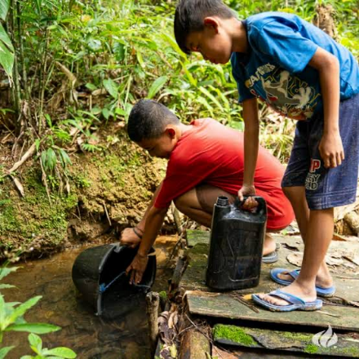
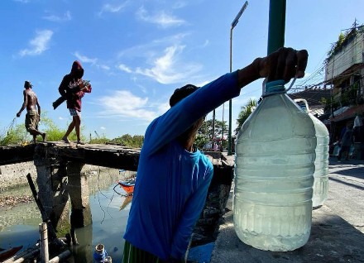
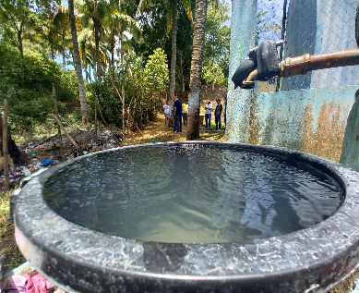
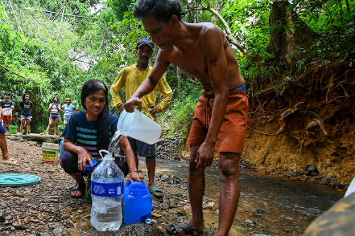
In many remote communities, children drink water from rivers, streams, or shallow wells. Not because they want to. But because they have no other choice…

Slide 5
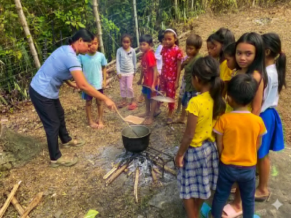
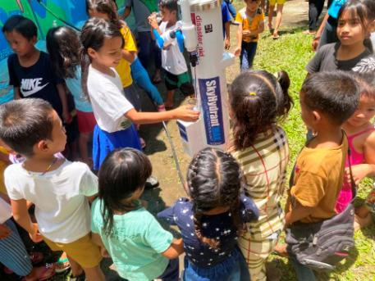
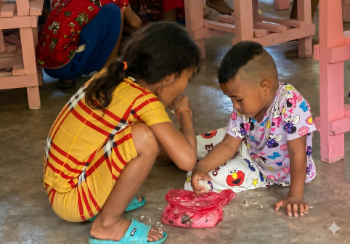
The Agkir Agkir Story:
More than half of the public schools in the Philippines have no safe drinking water facility

Slide 6
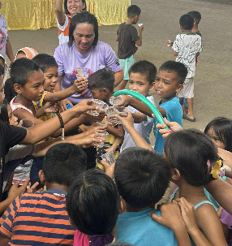
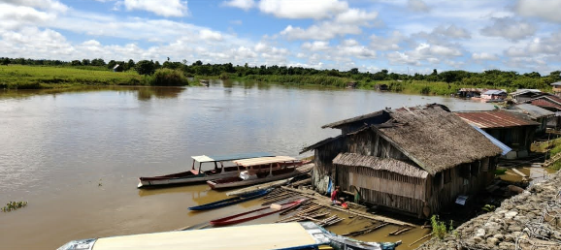
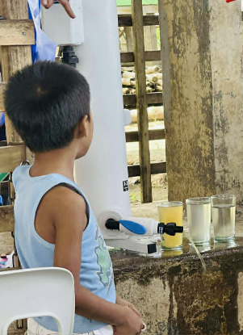
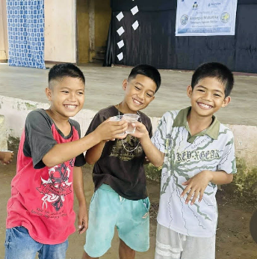
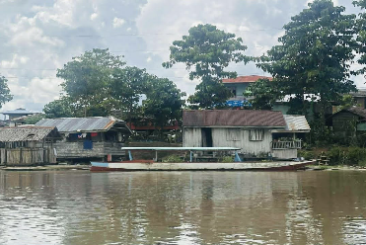
The Agusan Marsh Story:
Water is Life but it could also mean death.
“We are drowning, but we cannot drink.”

Slide 7
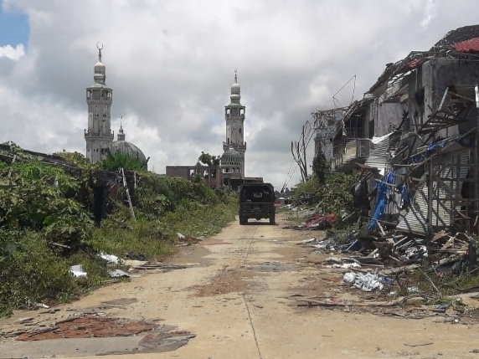
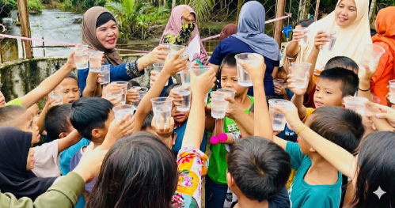
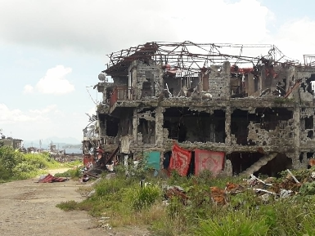
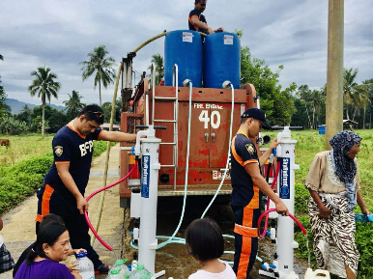
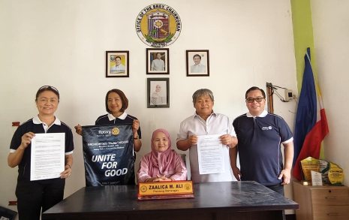
The Marawi Siege Story:
Hope, Dignity and Resilience Amidst Violent Conflicts

Slide 8
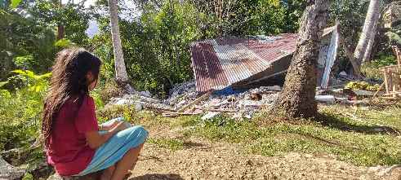
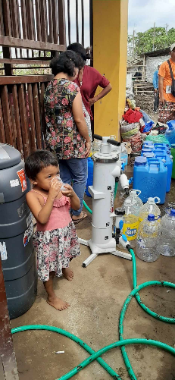
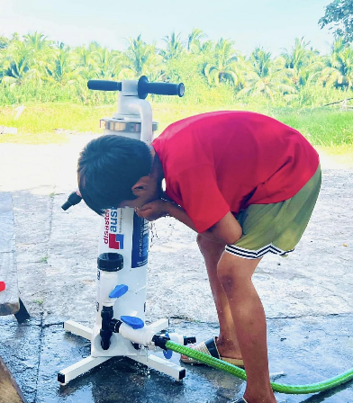
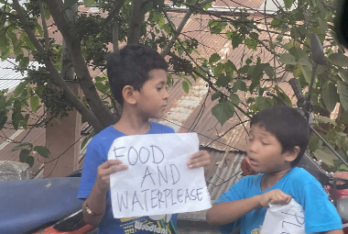
Our Disaster Response Story:
In the aftermath of these calamities, one of the first and most urgent needs is often invisible: Safe Drinking water.

Slide 9
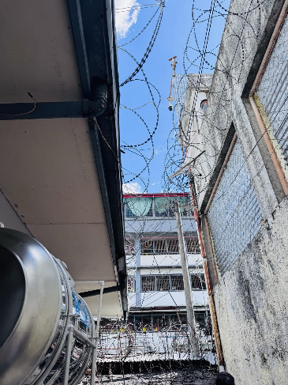
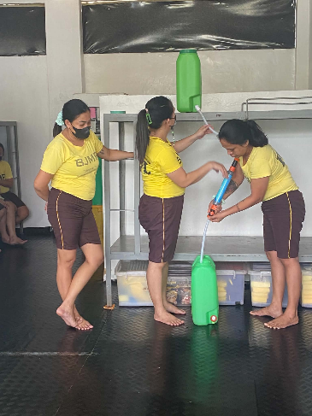
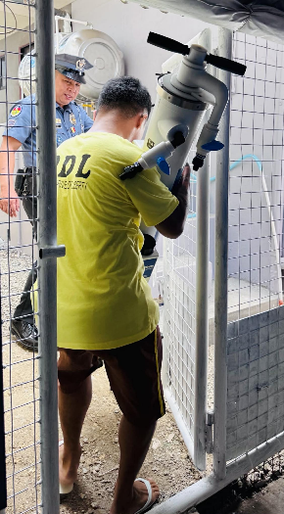
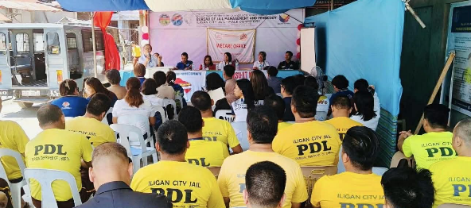
Persons Deprived of Liberty
Must Not Be Deprived of the Right to Safe Water

Slide 10

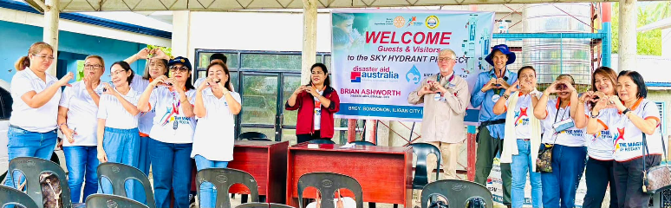
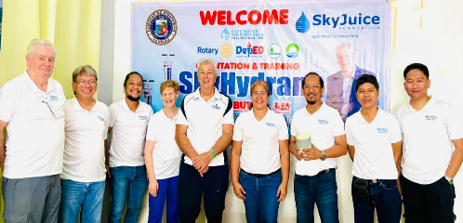
Our experiences in the Philippines have taught us one powerful lesson: Even the most vulnerable communities can regain hope when people choose compassion over indifference and action over silence.

