Slide 1




Seven Rotary Impact Areas with Safe Water
Speaker: Brian Ashworth
Honorary CEO Disaster Aid Australia

Slide 2



&

Slide 3


IS A PROJECT OF

Slide 4

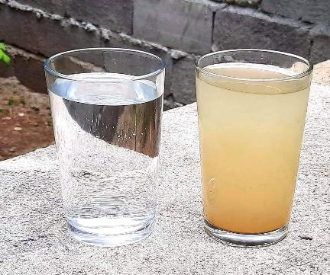
WATER, SANITATION AND HYGIENE
TO BE EFFICIENT WE CONCENTRATE ON OUR AREA OF EXPERTISE
OVER 400 INSTALLATIONS
SAFE WATER AFTER DISASTERS, & EVERY DAY
USE ULTRAFILTRATION SO NOT JUST ‘CLEAN’ BUT BACTERIA FREE!

Slide 5

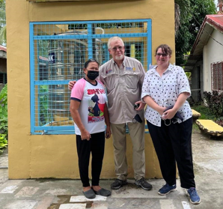
DISEASE PREVENTION AND TREATMENT
80% OF ILLNESS IN DEVELOPING COUNTRIES IS A RESULT OF CONTAMINATED WATER.
DISEASES INCLUDE DIARRHOEA, CHOLERA, DYSENTERY, TYPHOID, POLIO AND PARASITIC INFECTIONS.
SAFE DRINKING WATER IS ESSENTIAL TO TREAT PEOPLE SUFFERING FROM DISEASES RELATED TO CONTAMINATED WATER.

Slide 6

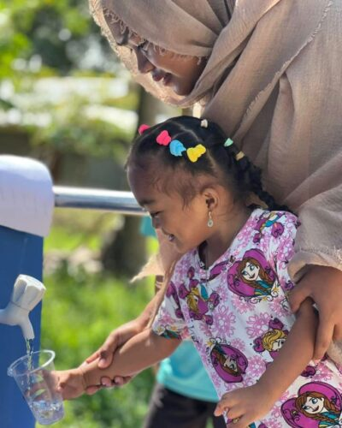
MATERNAL AND CHILD HEALTH
MOTHERS NEED GOOD HEALTH DURING PREGNANCY & TO CARE FOR YOUNG CHILDREN.
AROUND 40% OF 1,000,000 YEARLY DEATHS ARE CHILDREN UNDER THE AGE OF 5

Slide 7

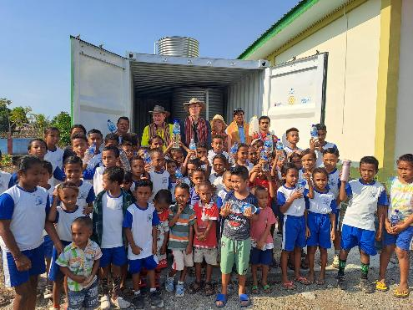
BASIC EDUCATION AND LITERACY
SAFE WATER REDUCES
PUPIL ABSENCES ( 70% +)
INTERUPTIONS TO LESSONS

Slide 8

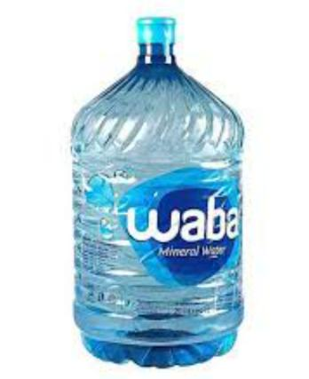
COMMUNITY ECONOMIC DEVELOPMENT
SOME PHILIPPINE STATISTICS
A FAMILY OF FOUR NEEDS TO DRINK 10LITRES/DAY TO STAY HEALTHY.
THE AVERAGE RURAL WAGE IS 322 PHP/DAY.
A 10 LITRE OF WATER BOTTLE COSTS 90 PHP.

Slide 9
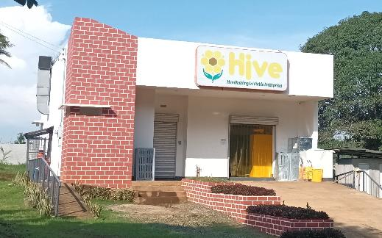
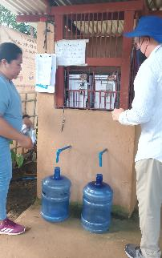
COMMUNITY ECONOMIC DEVELOPMENT
OPPORTUNITIES FOR NEW INDUSTRY
GENERATING FUNDS FOR COMMUNITY

Slide 10


ENVIRONMENT
AT LEAST 50 TONS LESS CO2 DUE TO:
LESS PLASTIC BOTTLES.
LESS WOOD USED TO BOIL WATER.
LESS PLASTIC WASTE
LESS DEFORESTATION

Slide 11

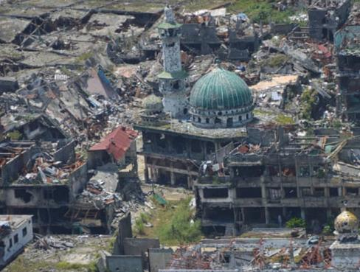
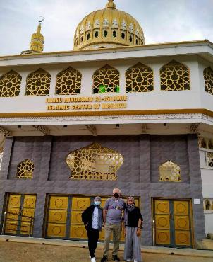
PEACEBUILDING AND CONFLICT PREVENTION
MARAWI 2018 MARAWI 2022

Slide 12

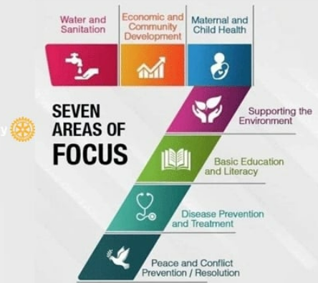
ONE PROJECT

Slide 13
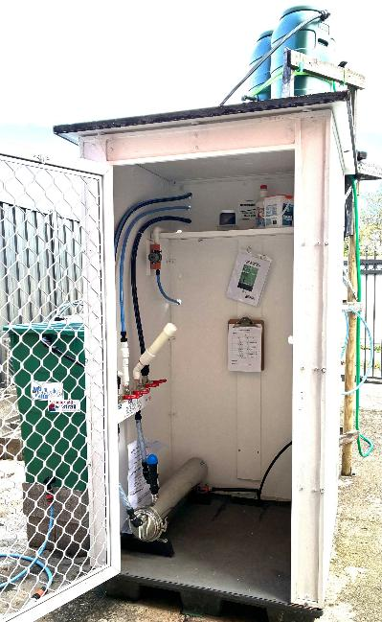
OUR FUTURE
SmartAid UltraFilter
  0.04micron Particle Removal
  10,000 Litres/Day
  No Power
  No Treatment Chemicals
  Simple Cleaning procedure
  2 x Filter Pressure Backwash
  Rugged
  Repairable In Country

Slide 14
LOOKING FOR PARTNERS
OUR PROJECTS
Helping in; Philippines, Timor Leste, Bhutan, Cambodia, Myanmar, Vanuatu.
AU$6,000 (US$4,000) to sponsor a Community or School.
Less than AU$1 (US$0.6) per person per year.
HELPING YOU
Add Safe Water to your Sanitation Project, Hospital Project, School, Community.
We can Supply a SmartAid UltraFilter for Au$1,800 (US$1,200) plus freight.
Training and support can be arranged.

Slide 15
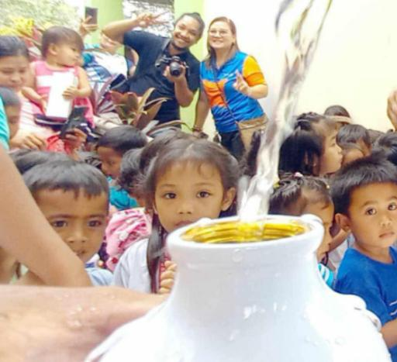
FURTHER INFORMATION
www.facebook.com/disasteraidaustralia/
www.disasteraidaustralia.org.au
YouTube - Disaster Aid Australia Channel
admin@disasteraidaustralia.org.au

