Slide 1




Providing Safe Water in Schools in Wartime
Speakers: Iryna Odyntsova, PP RC Dnipro Novyii
and Olha Paliychuk, DG Ukraine

Slide 2


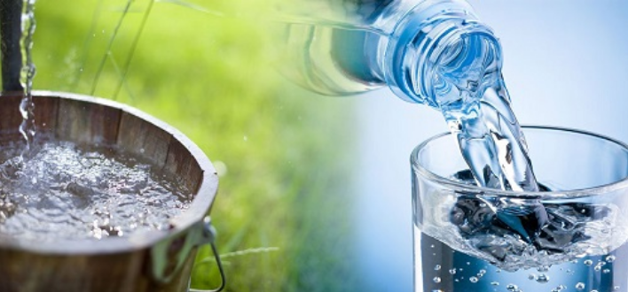



Slide 3

The ecological situation and state of drinking water in Ukraine
At the beginning of the war in February 2022, surface water was the principal source of drinking water for
more than 70% of the population of Ukraine

Slide 4



After more than five years of war
the situation has become much worse
Destruction of homes and infrastructure by Air raids, rocket and drone attacks
Environmental disaster
Forests and agricultural land destroyed and poisoned by mines and chemicals Water supply affected
Economic impact of war

Slide 5
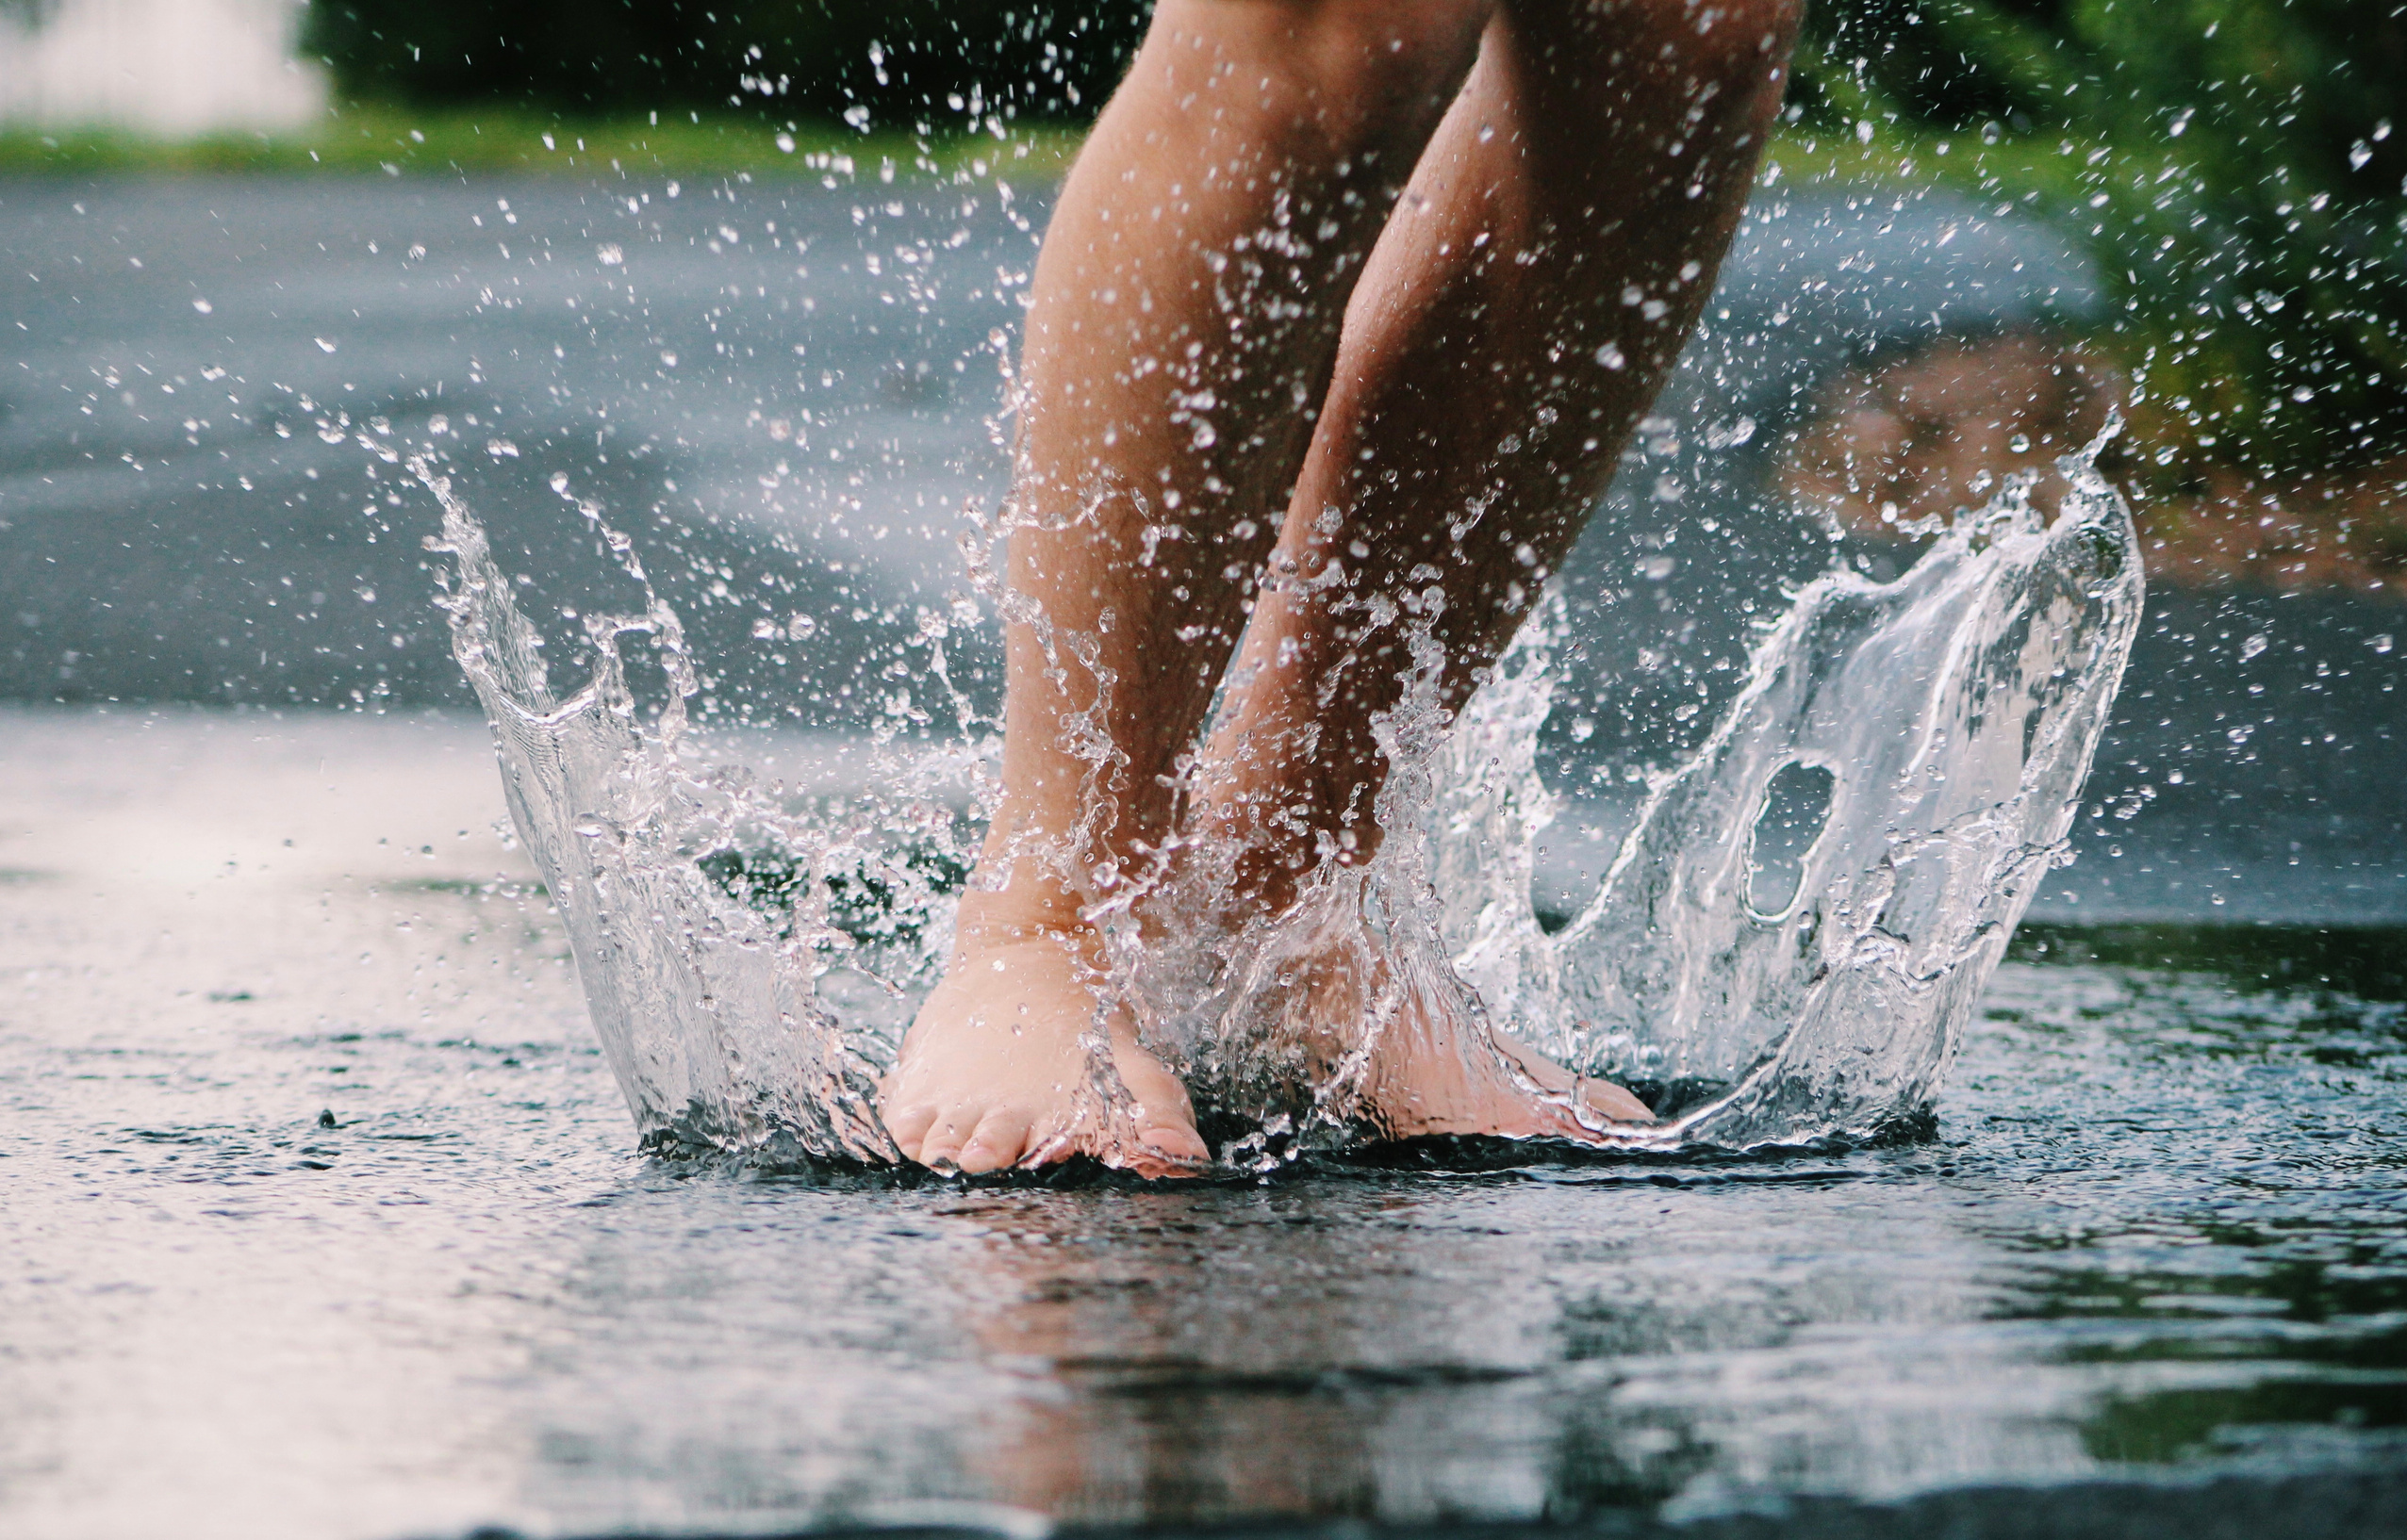
How Rotary is helping
OVER 2 BILLION
The equivalent in liters of safe drinking water received by Ukrainians thanks to the help of Rotarians worldwide

Slide 6
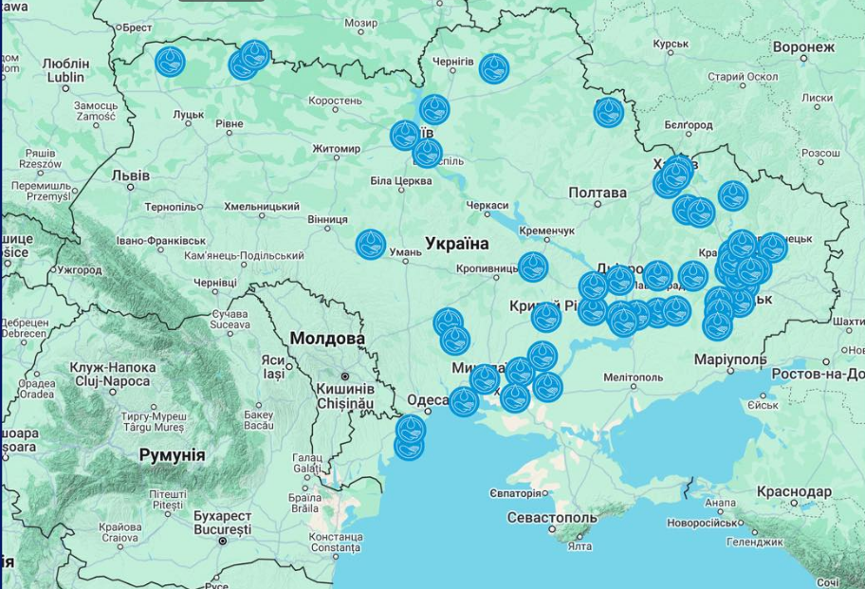

THE MAP SHOWS WHERE PEOPLE HAVE BEEN PROVIDED WITH FILTERS, TABLETS AND WATER PURIFICATION INSTALLATIONS

Slide 7

Example - Mobile Water Filtration
https://youtu.be/0dQQp3w5zI0?si=6BaRi0fwZLkYRqAg

Slide 8
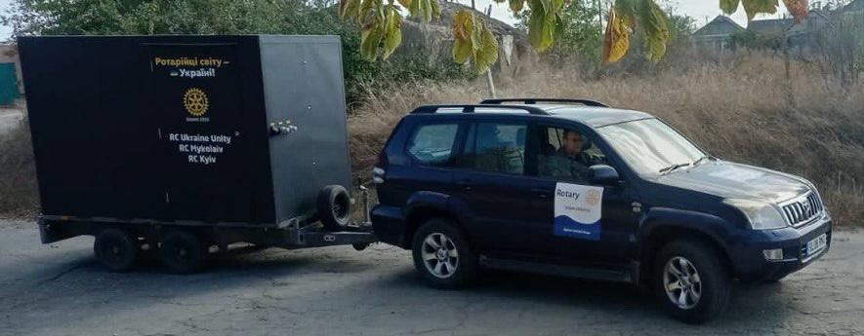
4 Units Operational in the Mykolaiv and Zaporizhzhya regions
Manufactured in Ukraine reverse osmosis filtration
Filters up to 12,000 liters of clean water per day
Global Grant approved for 3 units
$23,200 per unit
The first unit mobilized in the Kherson region was destroyed in drone attacks
Many more needed! Contact Ukraine WASH

Slide 9
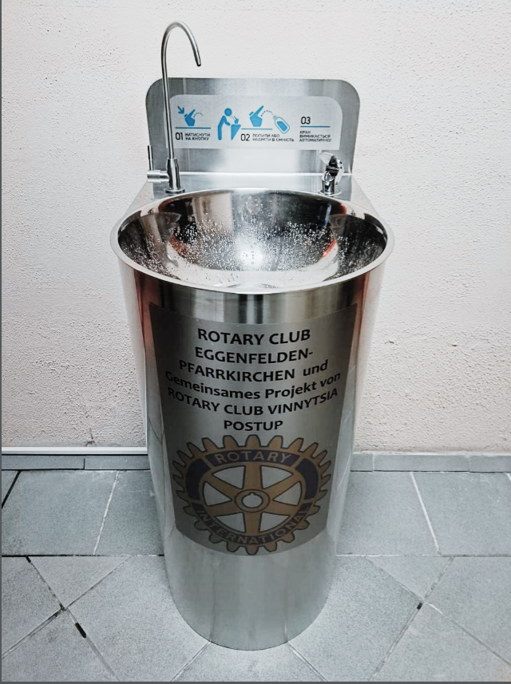
!
KEY GG PROJECT
Provision of drinking fountains for safe filtered water in those places where children are forcibly isolated for a long time (bomb shelters in schools, kindergartens, universities)
Installed 62 units
In progress 65 units

Slide 10
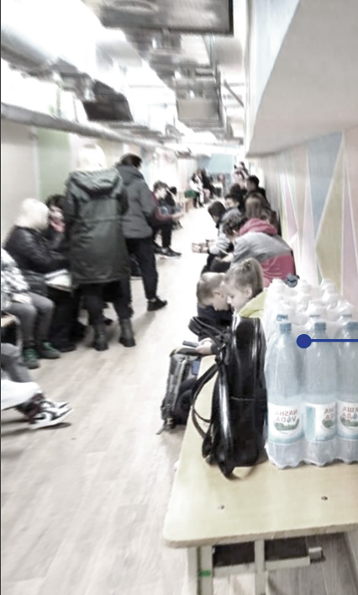
  Price of one fountain $1,500
  Manufacturer Ukrainian company AquaSet.
  Fountains have quality certificates and a 3-year manufacturer's warranty. Expected working life of a fountain is over 10 years
  Each donor leaves his mark and receives acknowledgement
  By supporting the project, you provide not only a source of clean water for children, but also work for Ukrainians

Slide 11
SAFE DRINKING WATER IN BOMB SHELTERS
https://youtu.be/EhLSuumZnyQ?si=CT8YEAs7gM9N4_lQ

Slide 12
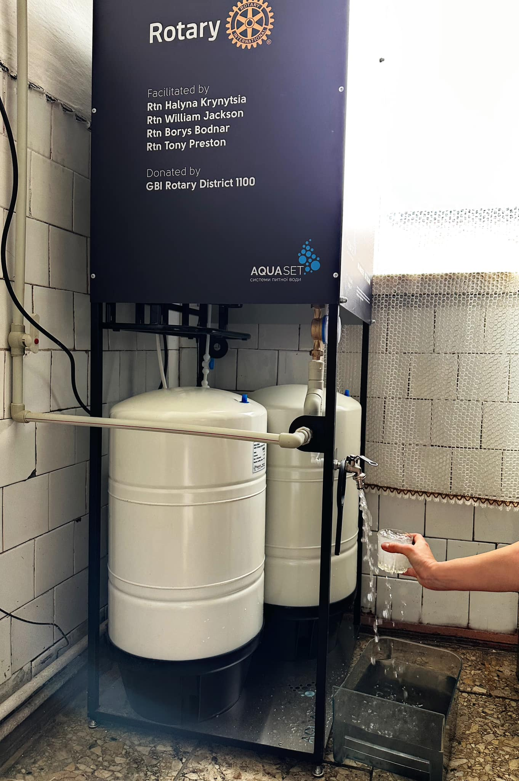
FILTER INSTALLATIONS
Installation of reverse osmosis filter stations for schools and hospitals around Ukraine, providing children and patients with safe drinking water and hospital and school kitchens with clean water for cooking.
Installed to date 6 units
Approx $3,500-4,000 per unit

Slide 13
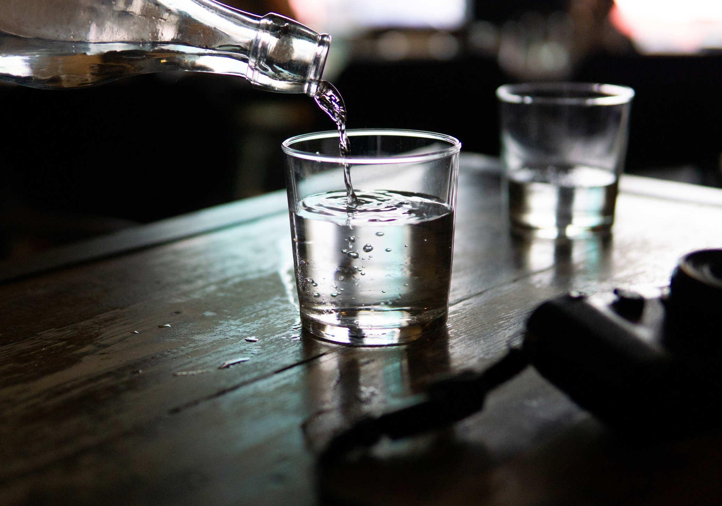
100% of your donation today will go to providing access to safe drinking water in UKRAINE
WASH Ukraine
Mark Gitelman
mmgitelman@gmail.com
+380674016359
Borys Bodnar (WASH RAG)
borysbodnar@gmail.com
+380980723872

