Slide 1
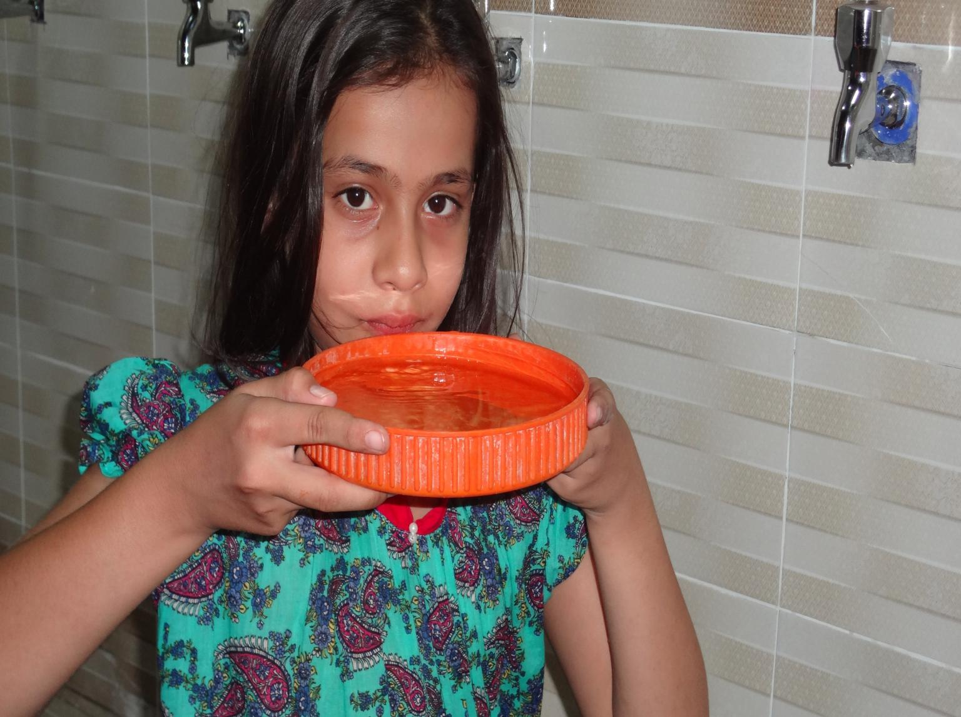
ZINDAGI – LIFE
A project to improve quality of life of women & children living in polio high risk areas through provision of safe drinking water through WASH interventions.

Slide 2
A WASH Initiative
Need for Clean Drinking Water
Objective: To implement sustainable, low-cost water filtration systems tailored to local needs.
Provide clean drinking water at easy approach
Reduce water borne diseases
Create creditability for polio vaccination teams
Approach:
  Community involvement in planning and maintenance
  Utilization of locally available materials
  Improve Health & Hygiene practices

Slide 3
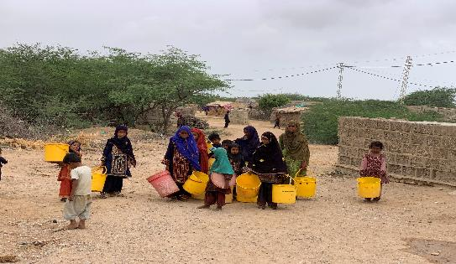
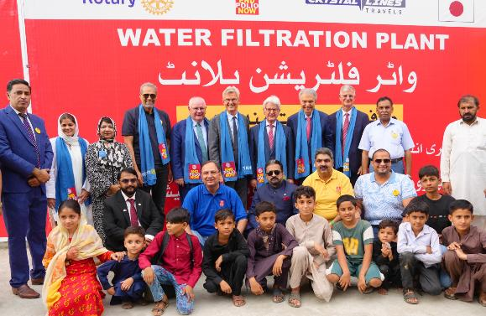
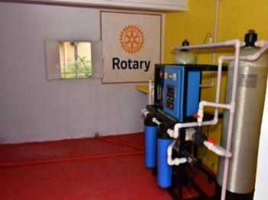

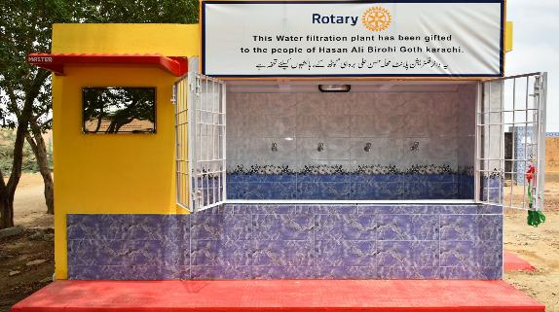
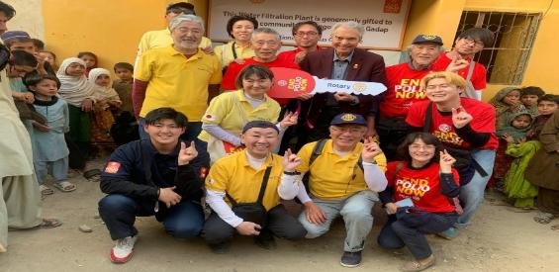
Water Projects
Total
53
Global Grant GG 119203
4 Water Filtration Plants
17
Rotary Club of North Carolina
3 Solar water Filtration Plants in Hyderabad and Lahore
Individual Rotarians
5 Water Filtration Plants
Global Grant GG 2117155
5 Water filtration Plants
2 Water Filtration Plants from PRIVP Johrita Solari
Global Grant GG 2124985
5 Water Filtration Plants
8 Water Filter& RO Plants from Japanese Rotarians
K-Electric Corporation
6 Water Filtration Plants

Slide 4
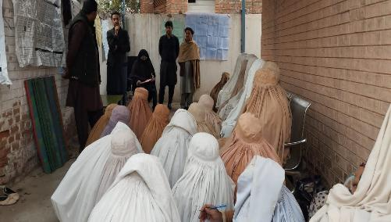
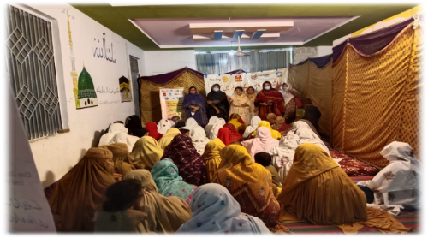
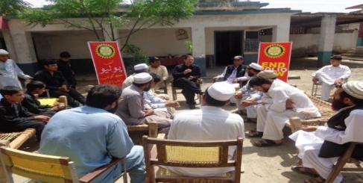
WASH Activities
Site Selection
Community Meetings
Construction & Installation Work
Health & Hygiene Workshops
Plant Operational & Management Trainings
Plant Inauguration
Health Awareness Workshops
Meeting with Public Sector Organizations
O&M Follow up Trainings

Slide 5
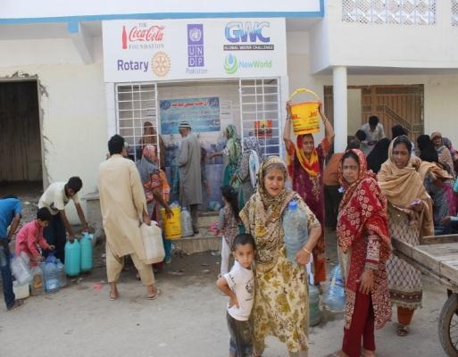
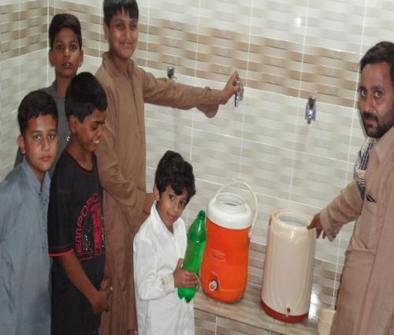
Project Beneficiaries
Total 53 Water Filtration Plants
Total household (500x53) = 26,500
Direct beneficiaries (26500x 8)= 212000
(Average household size is 8)
Reduced work load for 95400 Women
Secured 59360 children from water borne disease
Provide polio vaccination accessibility to 53 high risk areas.
Reduced 85% refusals in such communities

Slide 6
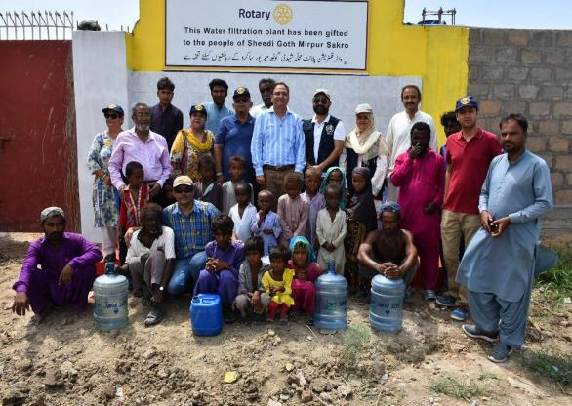
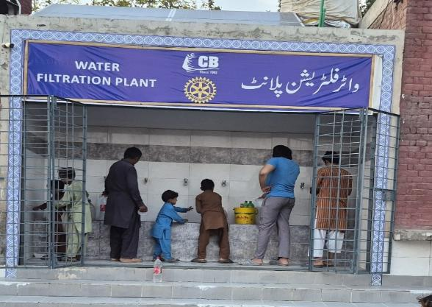
Project Outcomes
Reduced waterborne diseases such as cholera, typhoid, diarrhea, and hepatitis. Improved overall public health and lower mortality rates, especially among children.
More access to polio teams in security compromised areas
Better quality of life due to reliable access to clean water. Increased school attendance because children are less likely to become sick.
Reduced burden on women and children who may otherwise spend hours collecting safe water.
Awareness of Health & Hygiene.

